Slide 1
Sight-Reading Adventures
The Big Game
Suggested Age- 7th-8th Grade Tenor/Bass
Range- S, L, T, D, R, M, F, S, L (tonic triad skips)
Two-part, Tenor/Bass exercises
by Micah Bland

Slide 2
Instructions
Upon completing the sight-reading exercise, read the text. Students then select which path to take. Students vote for the path by displaying the corresponding Curwen hand sign and singing the designated pitch.
Click the text of winning path for a direct link to the next slide.
Students can sight read using any of the following combinations: chant, sing on solfege, or sing text.
Suggested combinations include
  First reading all sing solfege, second reading all sing text.
  Teacher sings text, students sing solfege.
  Half of the group sings text other half sings solfege.

Slide 3
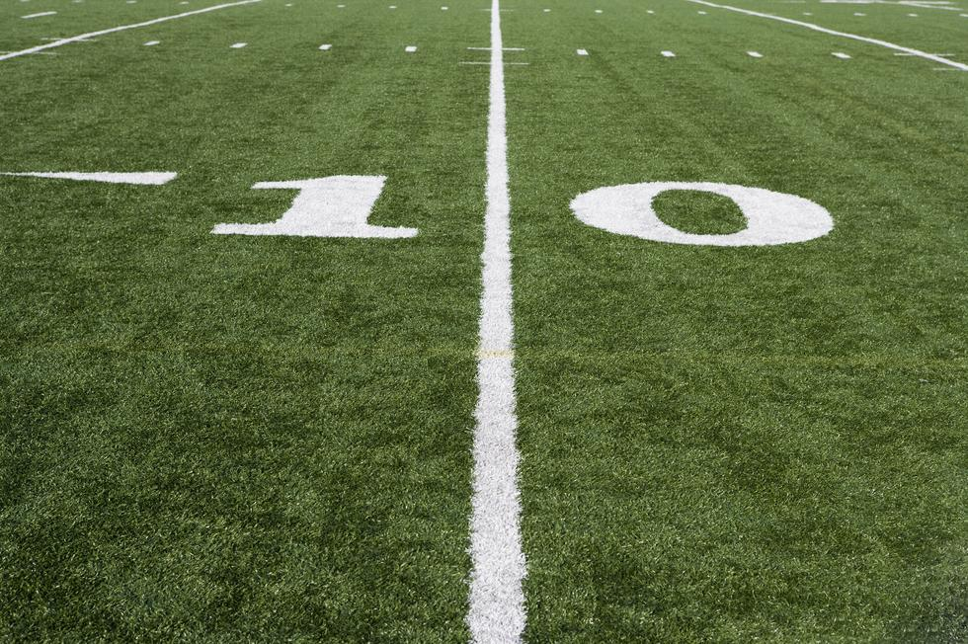
It’s the day of the big football game. Your team is ready to take on the Bull Dogs, your town rivals. As the star of the team, coach asks you if you would rather play offense or defense. Which will it be?
Choices Offense Defense
Do Mi

Slide 4
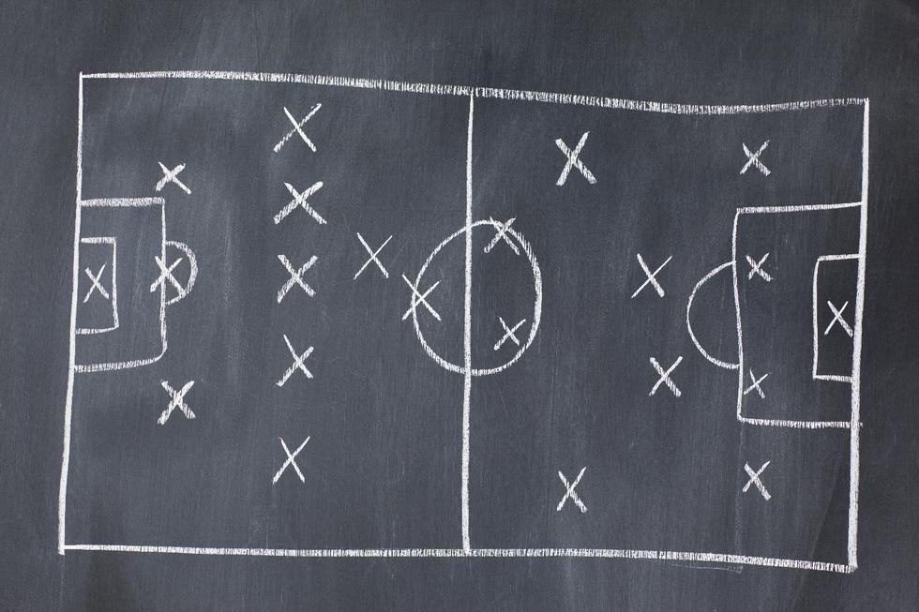
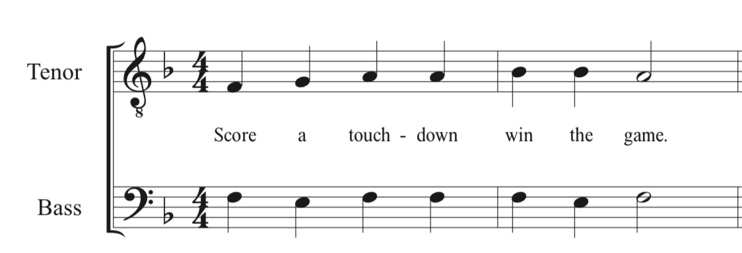
The game is in the 4th quarter. Your team is losing 21 to 24. As the quarterback of the team, it’s up to you to win the game. You huddle up, do you call a pass play or a run play?
Choices Pass Run
Mi So

Slide 5
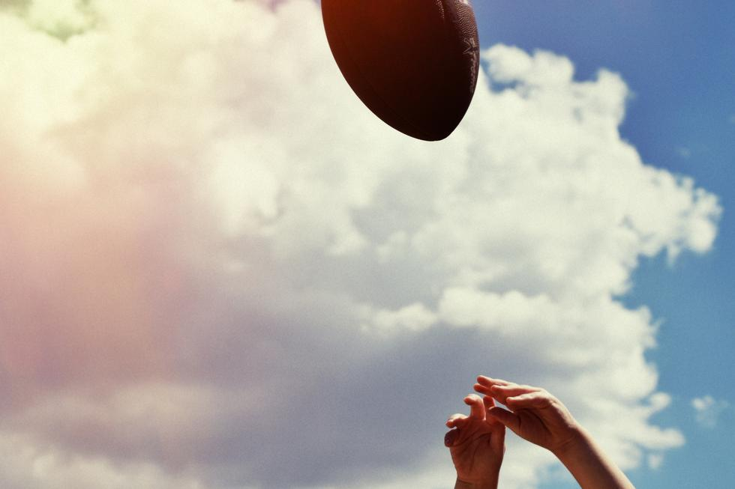
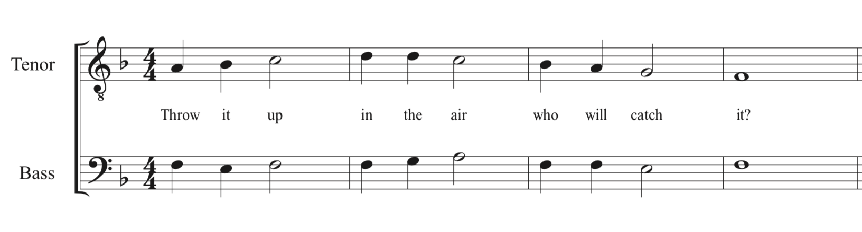
Hiking the ball, you drop back to pass. One of the defensemen breaks through your offensive line and is headed straight for you. In the distance you see your friend Jose about to shake his man and get open. Do you attempt the pass taking a big hit from the defensemen, or do you take off running?
Choices Pass Run
Do La

Slide 6
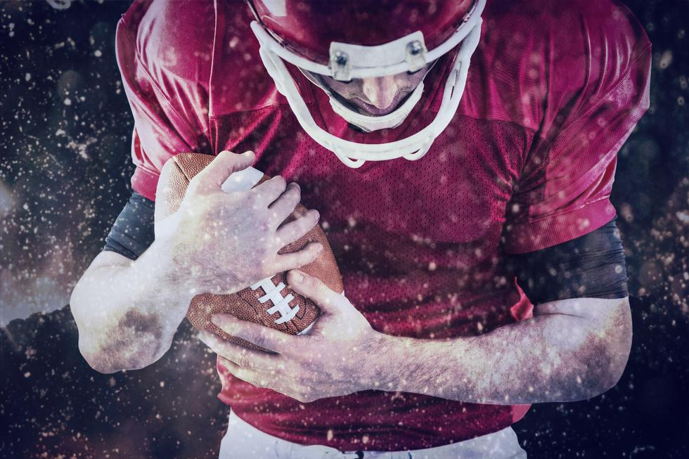
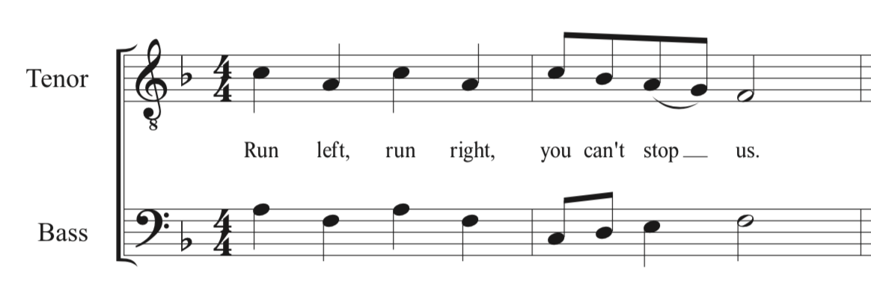
You decide to run the ball. That’s a great choice, with the best running back in the city, you’re sure to wrap up this game with a win. Do you run to the left or to the right?
Choices Run Left Run Right
La Do

Slide 7
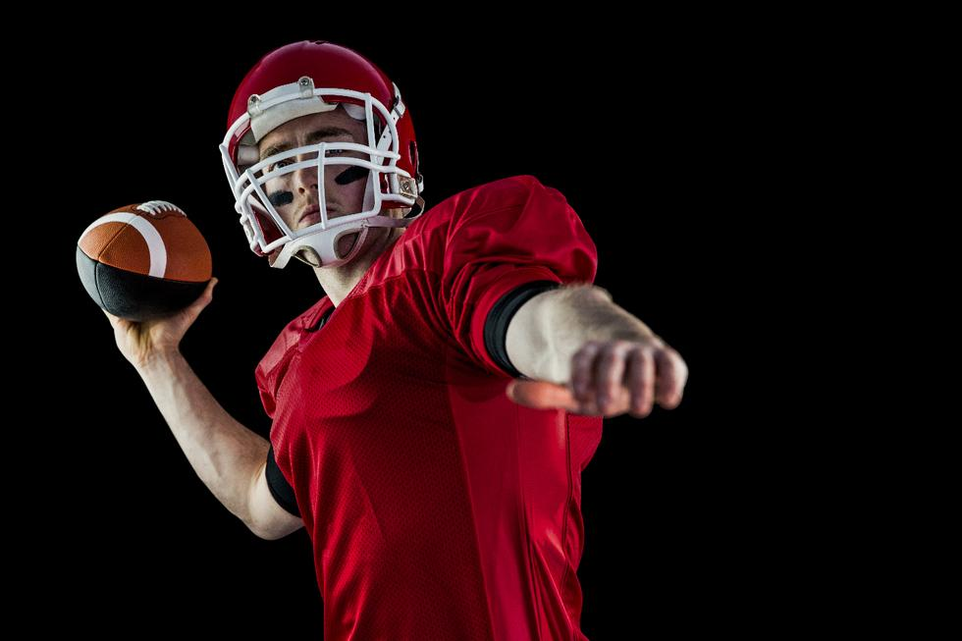
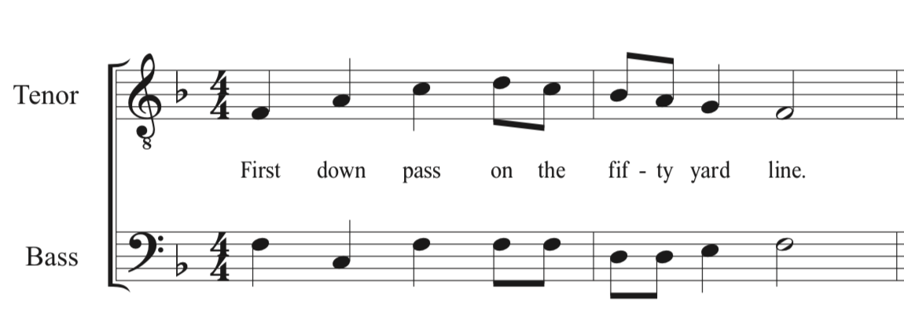
You throw the ball to Jose, and immediately take a big hit knocking you to the ground. Lying on your back you hear the crowd erupt in applause, Jose catches the ball and is tackled on the 50 yard line. The game clock ticks down to 10 seconds. You have time for one more play. You hike the ball, as you drop back you see you have a man open, but they’re only five yards down the field. Do you throw the five yard completion and hope he runs it in for a touchdown, or throw the Hail Mary in the end zone?
Choices 5 Yard Pass Hail Mary
So Do

Slide 8
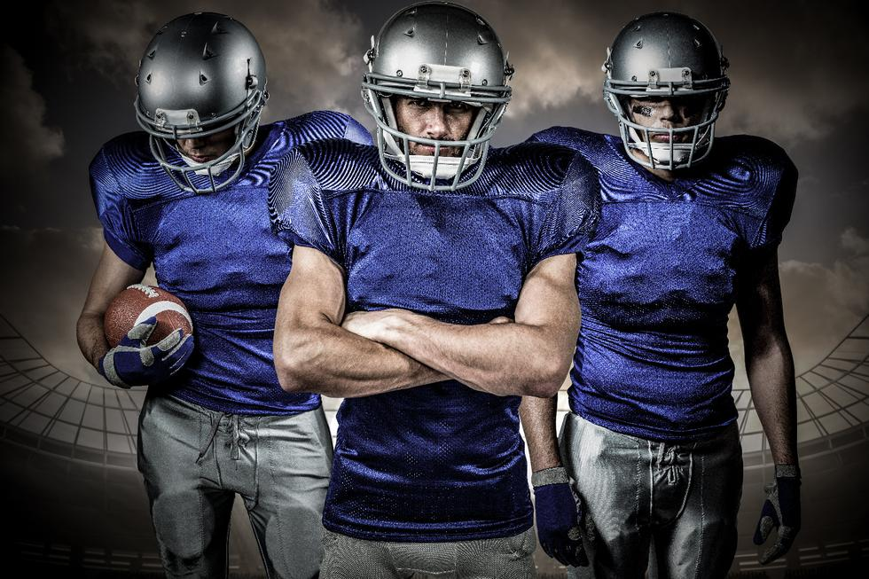
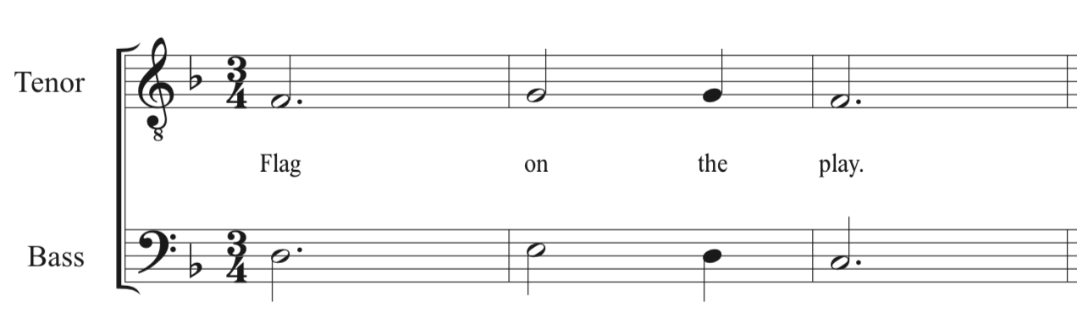
You run left and find a hole. You take off running breaking through their lines. First Down! But wait, there’s a flag on the play. The referee announces, holding offense, 10 yard penalty, repeat first down. As the clock is stopped at 5 seconds there are only two choices left. Do you throw a Hail Mary for the win, or do you kick a 55 yard field goal to try and tie?
Choices Hail Mary Field Goal
Do Mi

Slide 9
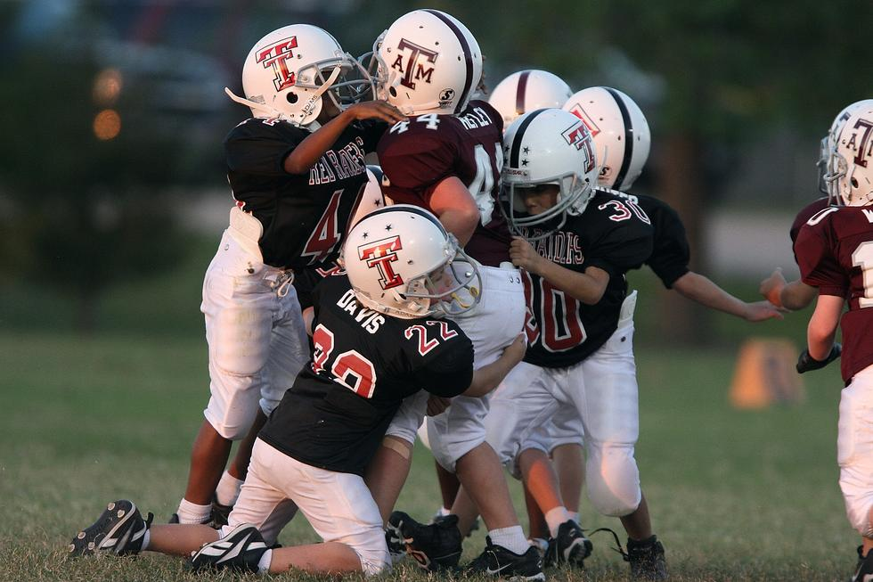
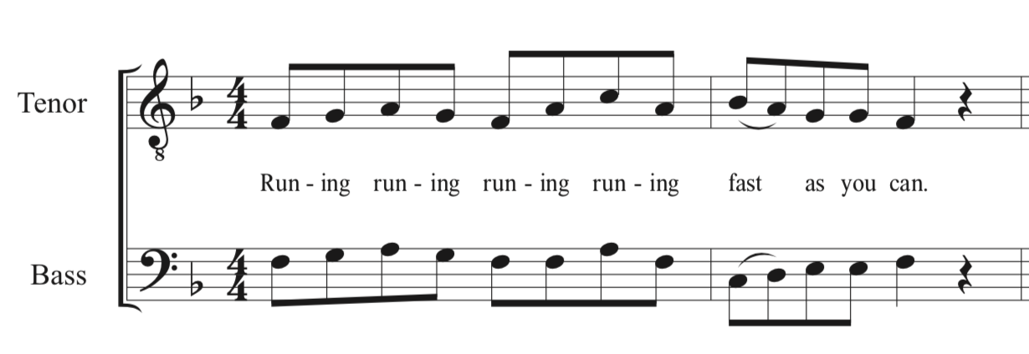
You hand the ball to the running back, he finds a hole and takes off. He steps out of bounds at your opponents 30 yard line, stopping the clock with only 5 seconds left. With time almost out, do you kick the field goal for the tie, or throw the ball for the win?
Choices Field Goal Pass
Mi Do

Slide 10
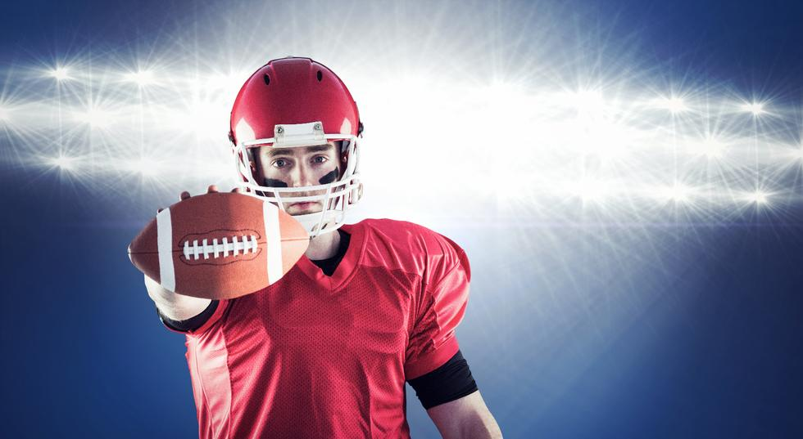
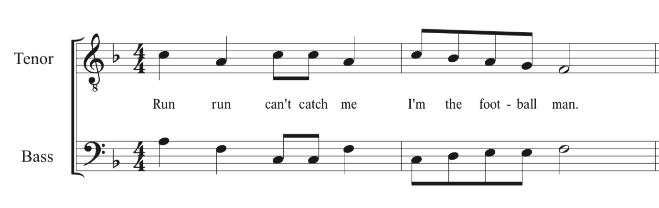
You throw the ball to the open receiver 5 yards down the field. He takes off running. He’s at the 40. . . the 30. . . the 20. . . He breaks one tackle, at the ten he gets wrapped up by the other team, but wait he laterals the ball back to your friend Justin. Catching the ball Justin has one man to beat. Diving for the end zone you see the referee's arms go up, TOUCHDOWN! Your team wins the game!

Slide 11
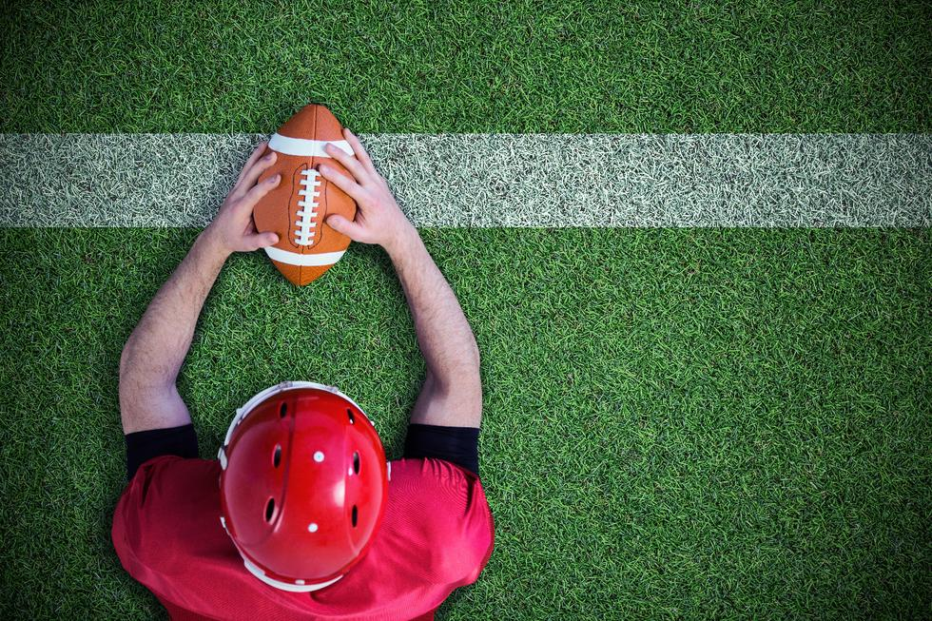
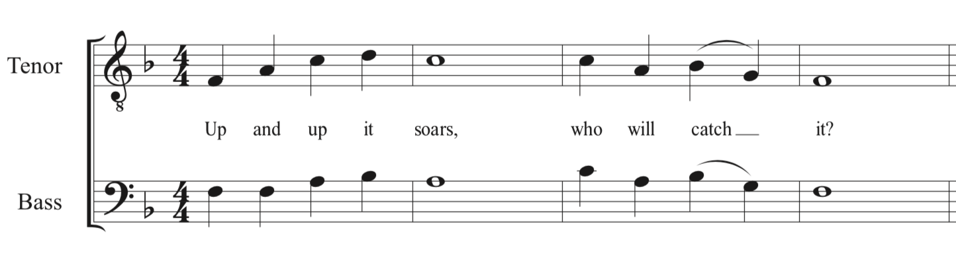
You drop back to pass. With all your strength you throw the ball down the field. The defensive cornerback tips it, the crowd holds their breath as the ball pops up in the air in the end zone. As the group of players collide, from within the pack you see Ryan leap up out of nowhere grabbing the ball. TOUCHDOWN!!!!!

Slide 12
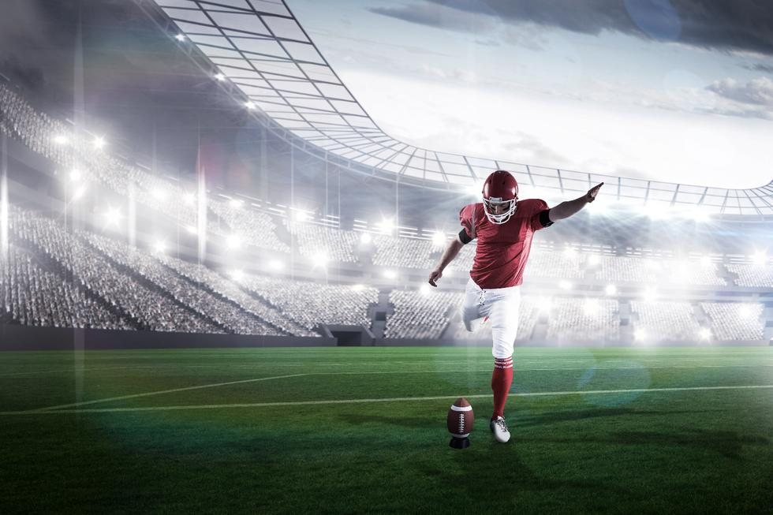
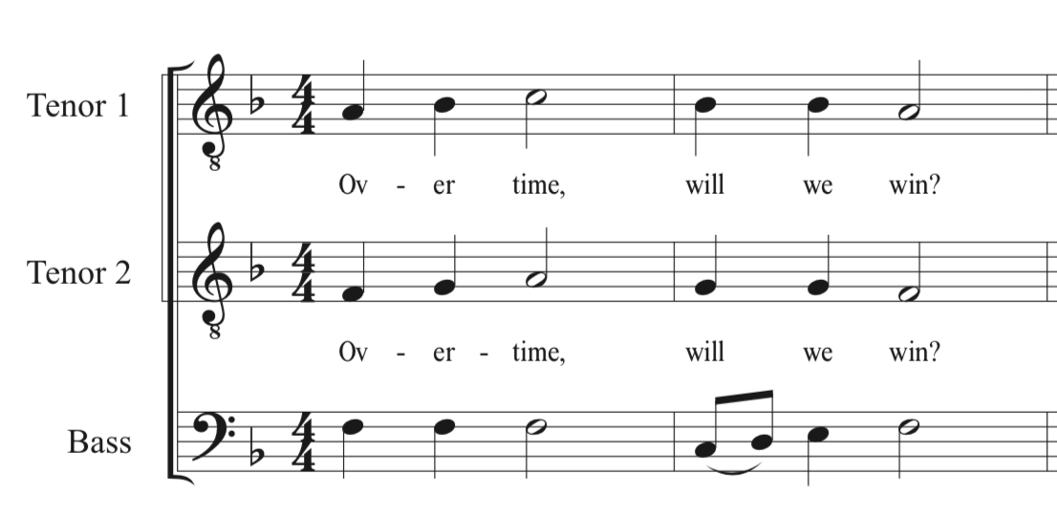
The kicker lines up. Your entire season has come down to this moment. The kick is up, it looks to be straight, but does it have the distance? The ball falls through the uprights. You have tied the game. To win the game in overtime you must sight read the following exercise in 3 parts.

Slide 13
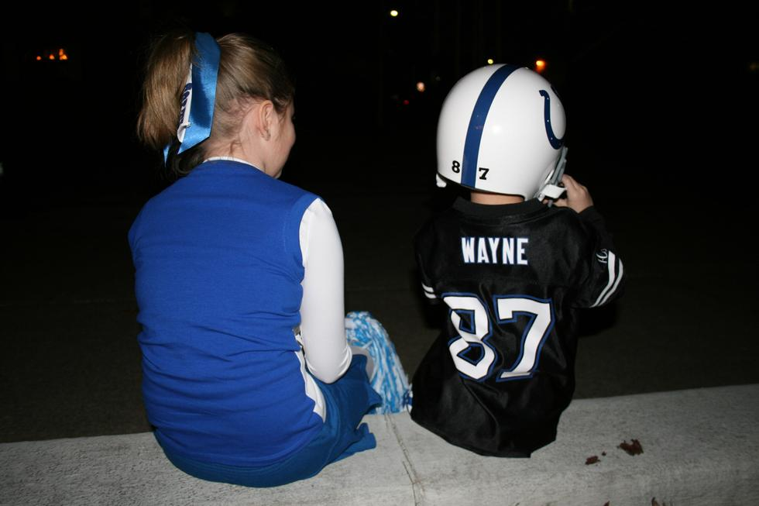
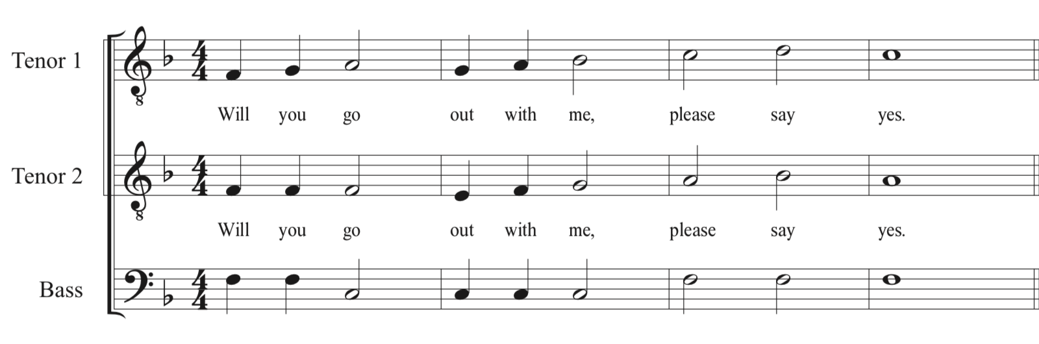
The moment has come, the final play of the game. You drop back to pass, suddenly out of the corner of your eye you spot your crush, Heather, the cheerleading captain. In this moment of distraction you don’t realize the blitz coming from behind you. Smack, you are hit in the back, the ball falls out. Game over. . . or so you think. As you open your eyes you see Heather running over to you. She says, ”Are you all right?” You reply, “I would be better if you went on a date with me.” Sing this exercise correctly in three parts for Heather to say YES.

Slide 14
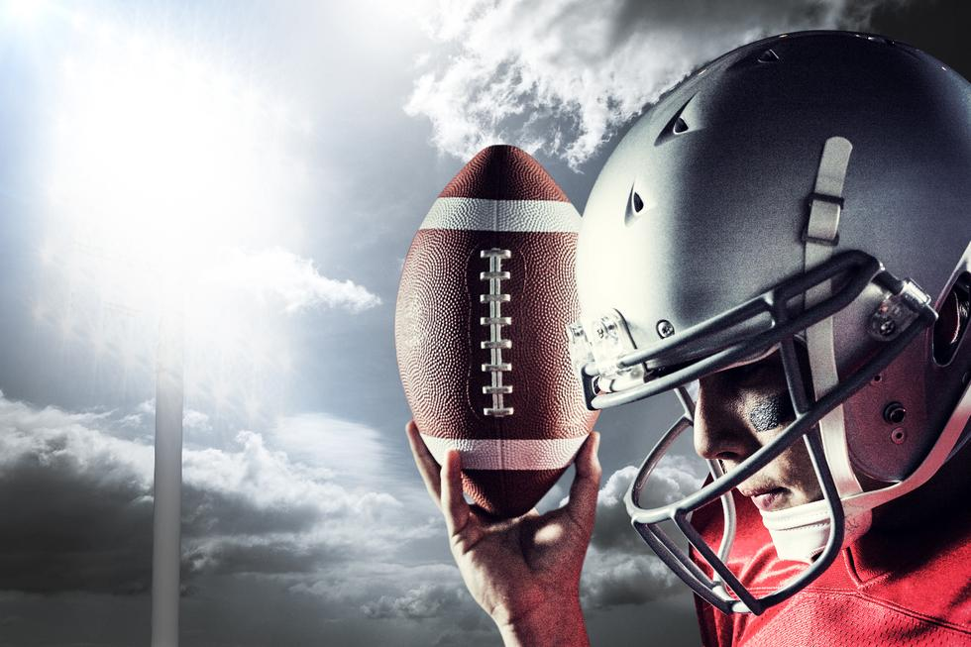
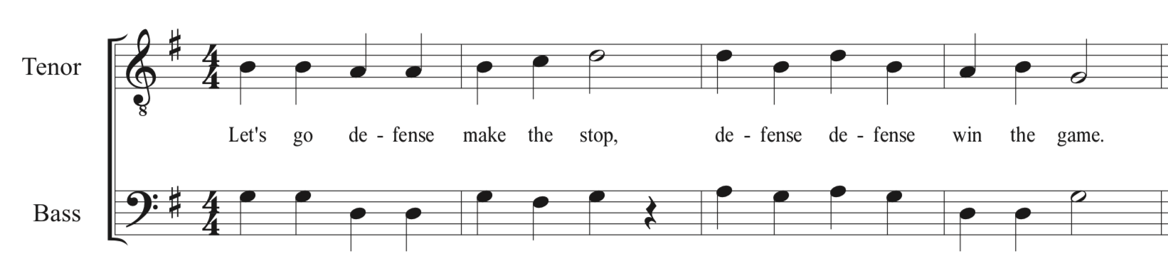
It’s the 4th quarter with only 3 minutes left in the game. Your team is winning 14 to 13. To stop the other team and win the game do you play linebacker or defensive line?
Choices Linebacker Defensive Line
So Do

Slide 15
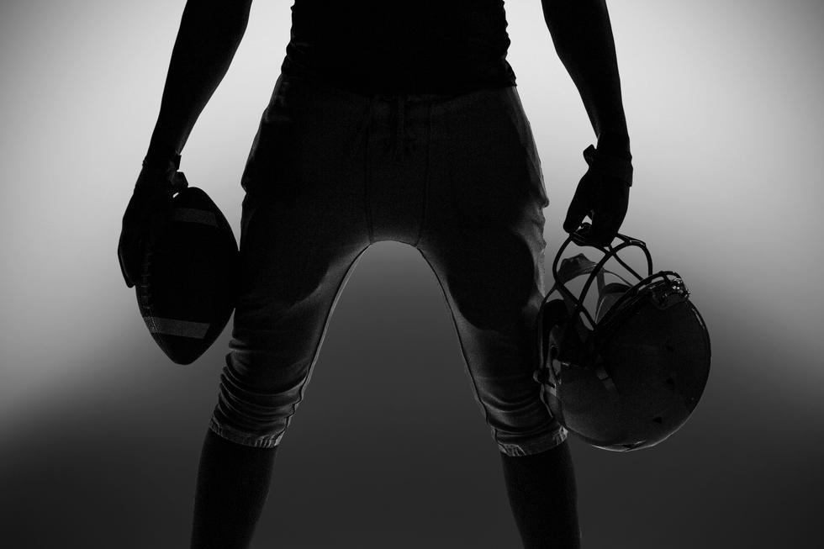
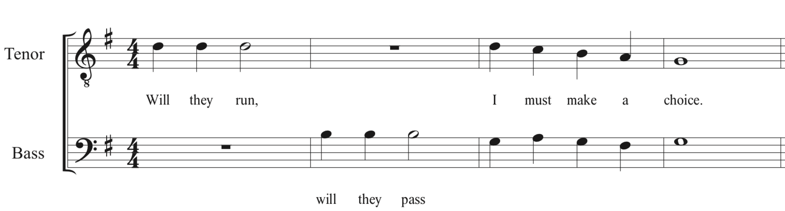
Coach puts you in as middle linebacker. The offense hikes the ball. Do you cover the pass or blitz the quarterback?
Choices Cover Pass Blitz Quarterback
Mi So

Slide 16
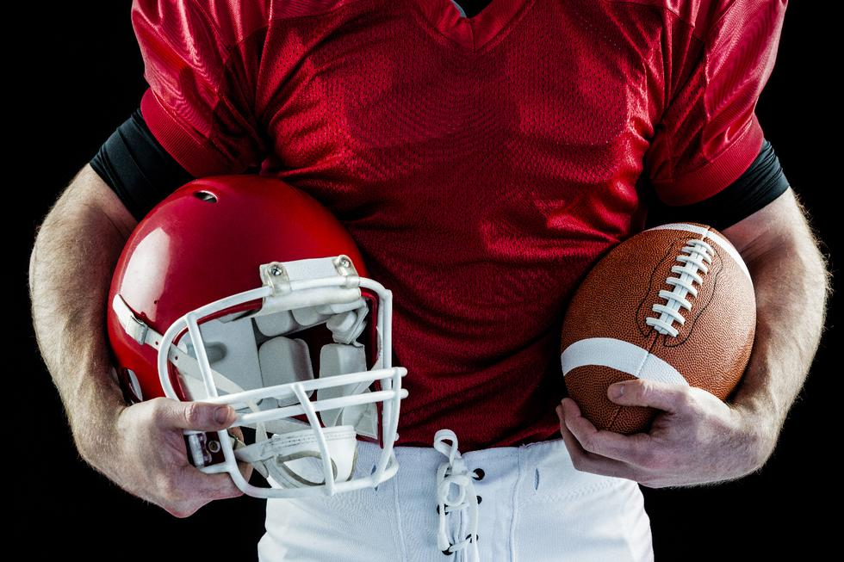
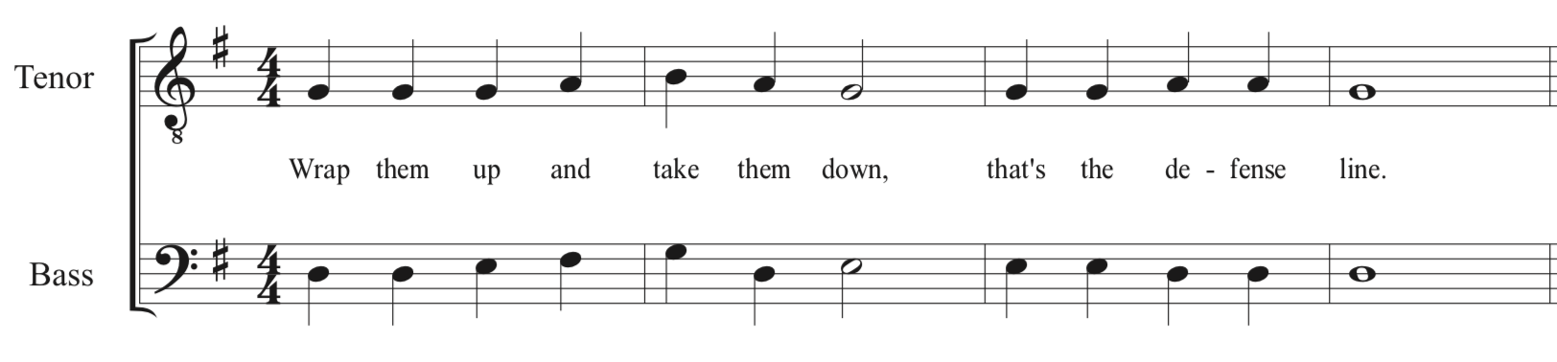
You run onto the field and line up on the left side of the defensive line. The quarterback hikes the ball. Do you contain the run to the left, or spin inside to rush the quarterback?
Choices Contain left Rush inside
So Do

Slide 17
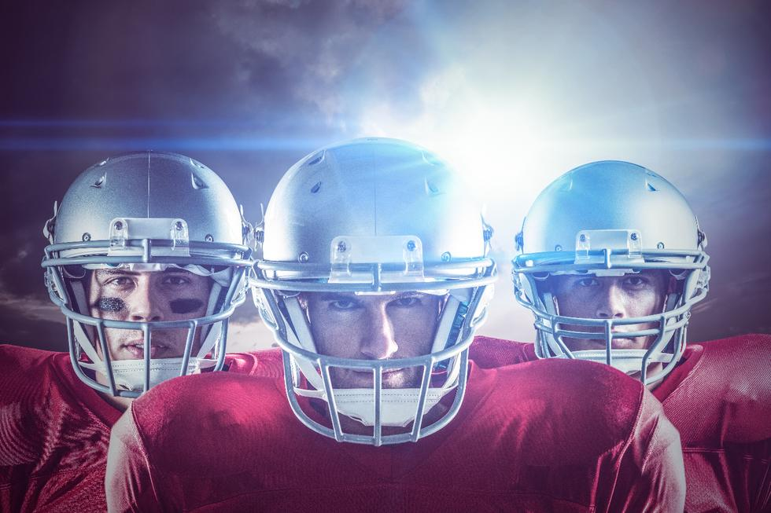
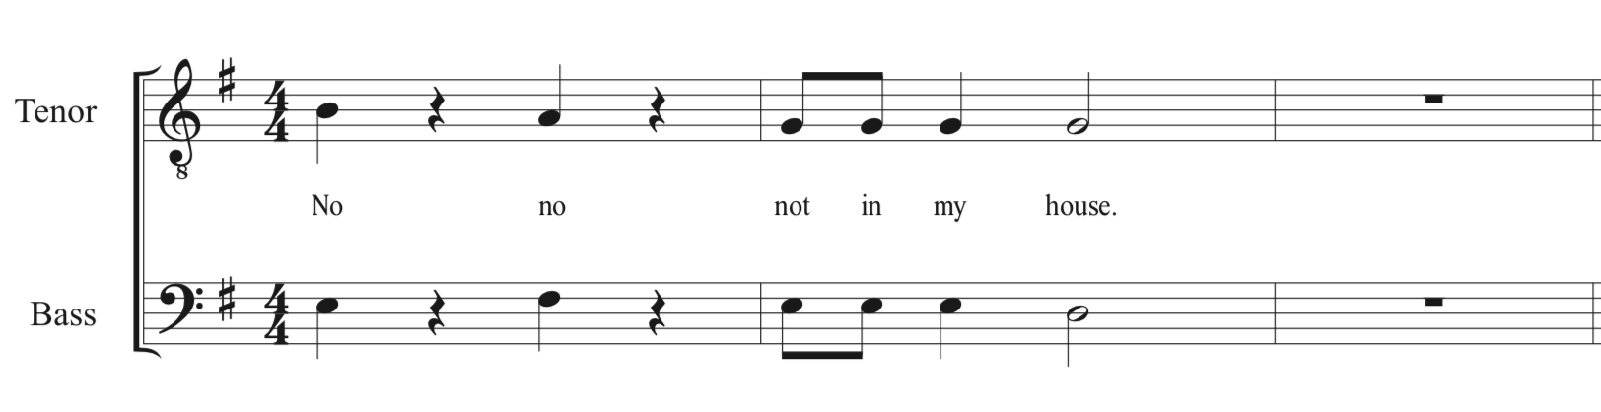
You drop back in zone coverage. Out of the corner of your eye you see the wide receiver running a slant route. You fly over, stick your hand out and knock down the ball. Incomplete pass. With only seconds left on the clock the other team has one shot left. Do you play safety left or right?
Choices Left Right
Do So

Slide 18
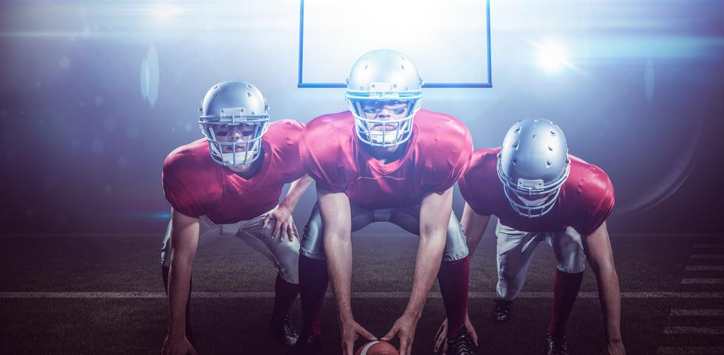
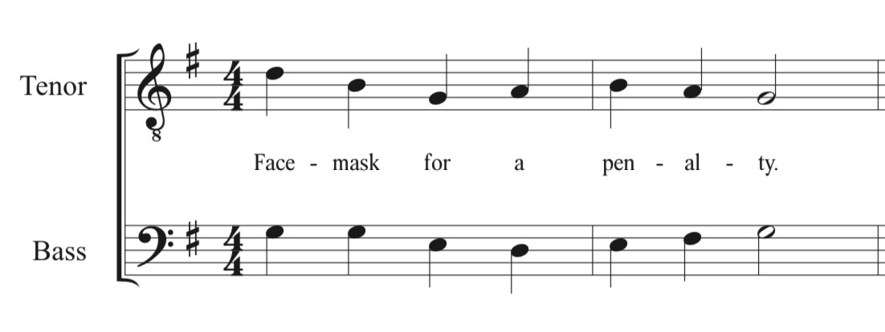
You make an incredible move, and squeeze by the offensive line. The quarterback runs to his right. As you chase him down you reach out to tackle him. Without realizing your hand grabs his facemask. The umpire announces, facemask, defense, 15 yard penalty, first down. With that penalty the other team is now in field goal range. Do you line up on the left or right to try and block the field goal?
Choices Left Right
Do Mi

Slide 19
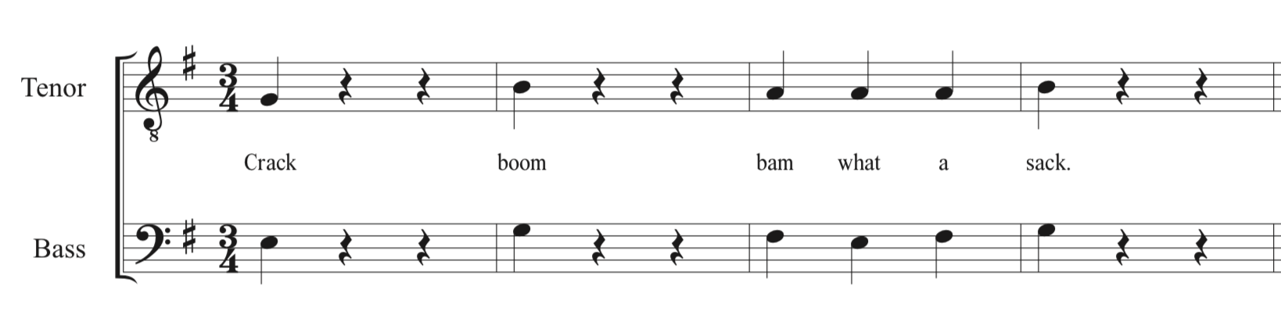
You make a move and have a direct line to the quarterback. With a loud crash you knock him to the ground. Sack for a loss of 8 yards. With time running out the other team only has time for one more play. Do you play safety left or safety right?
Choices Left Right
Do La

Slide 20
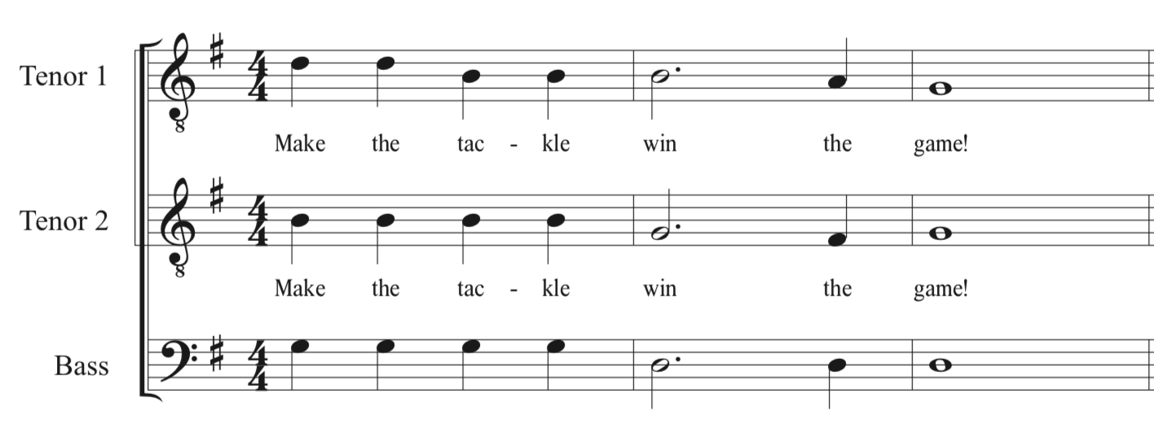
You line up on the left side 30 yards deep. Their only shot is a hail Mary pass. They hike the ball, but what’s this they throw a short 10 yard pass. It’s caught, your entire team converges on the receiver. Just before he’s tackled he tosses it back to another player. With the rest of your team piled up on the other player, it’s down to you to make the play. Successfully sight read the following exercise in 3 parts to make the tackle and win the game.

Slide 21
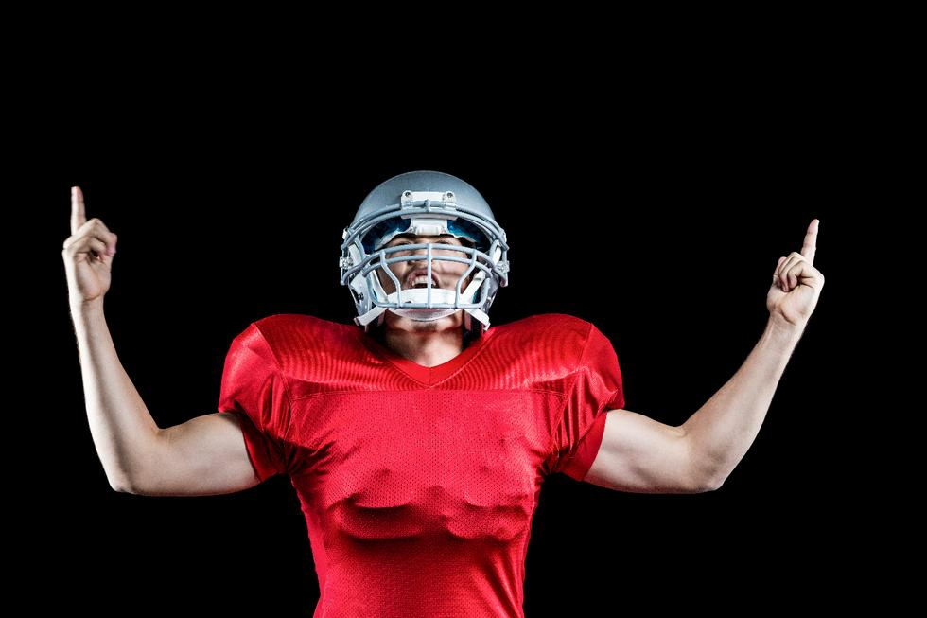
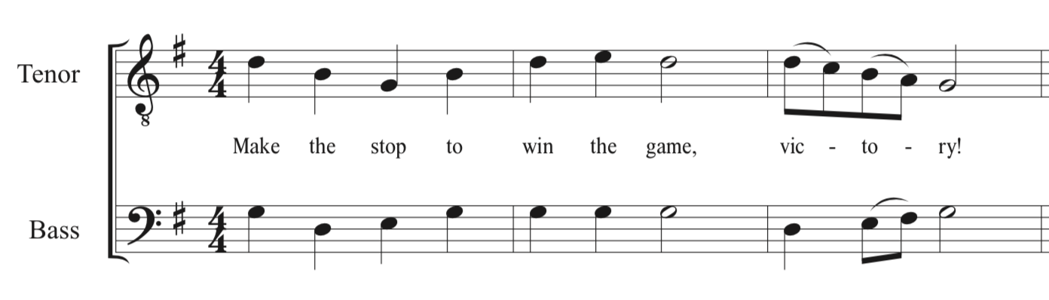
You line up in the safety right position. The quarterback drops back and heaves the ball down the field. You leap up with all your might. Reaching out you swing at the ball and knock it away from the receiver. Incomplete pass, you win the game!

Slide 22
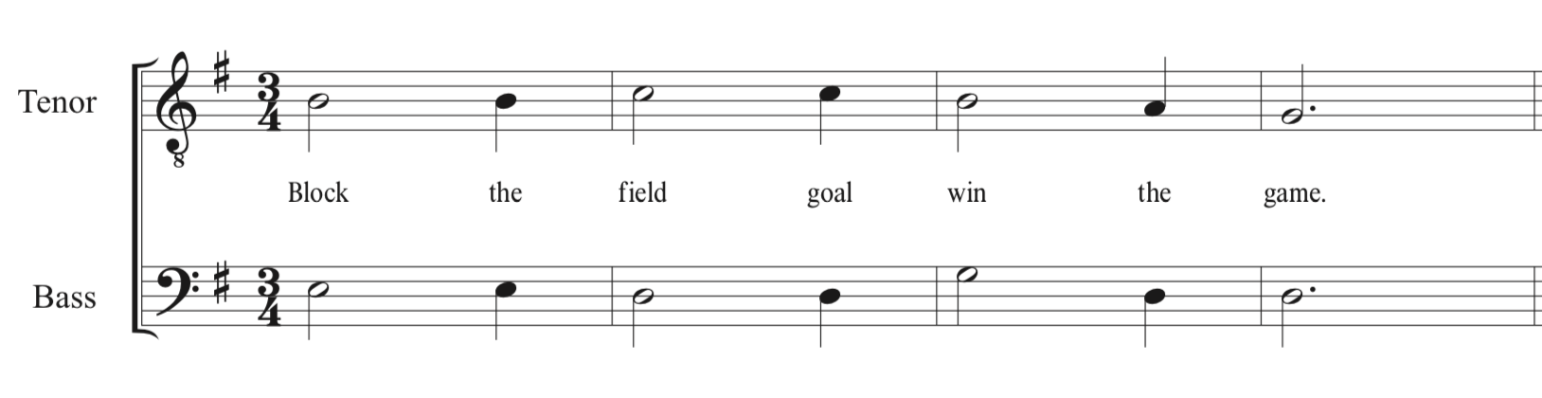
This is it, with only 10 seconds left in the game you have one final chance to win. They line up to kick a field goal. They hike the ball, you run as fast as you can around the outside, but you don’t get there in time. The kick is up. . . wide right! No good. You win the game!

Slide 23
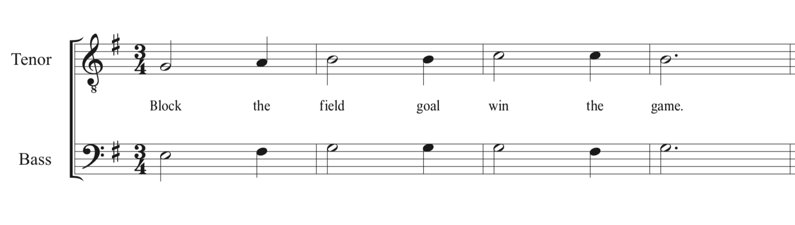
This is it, with only 10 seconds left in the game you have one final chance to win. They line up to kick a field goal. They hike the ball, you run as fast as you can around the outside, but you don’t get there in time. The kick is up. . . it soars through the center of the goal posts. Your team loses the game. You can’t win them all, better luck next time!

Slide 24

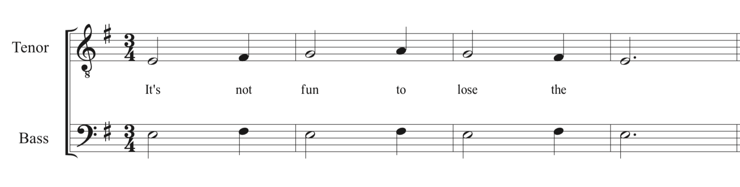
You line up safety right. The ball is hiked. Out of the corner of your eye you are startled by something. A giant bulldog mascot is running down the sideline towards you. Getting your head back in the game, you realize the ball has already been thrown. You are too far away to stop him. Touchdown! Your team loses 20-14.

