Slide 1
Sight-Reading Adventures
Road Trip
Suggested Age- 4th to 6th grade
Range- la, ti, do, re, me, so
Unison exercises in treble clef
By Micah Bland

Slide 2
Instructions
Upon completing the sight-reading exercise, read the text. Students then select which path to take. Students vote for the path by displaying the corresponding Curwen hand sign and singing the designated pitch.
Click the solfege text of winning path for a direct link to the next slide.
Students can sight read using any of the following combinations: chant, sing on solfege, or sing text.
Suggested combinations include
  Teacher sings text, students sing solfege.
  Half of the group sings text other half sings solfege.

Slide 3
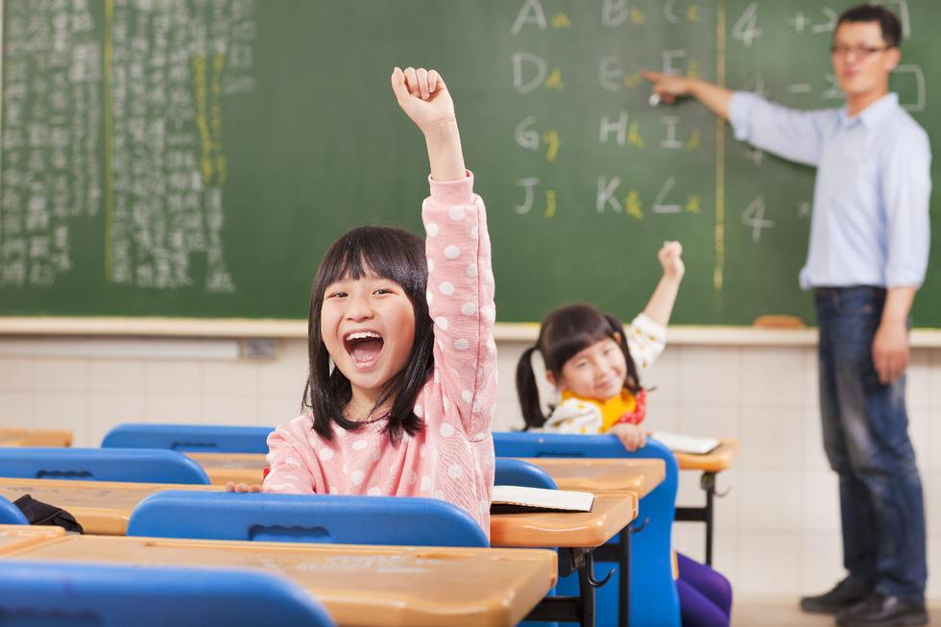
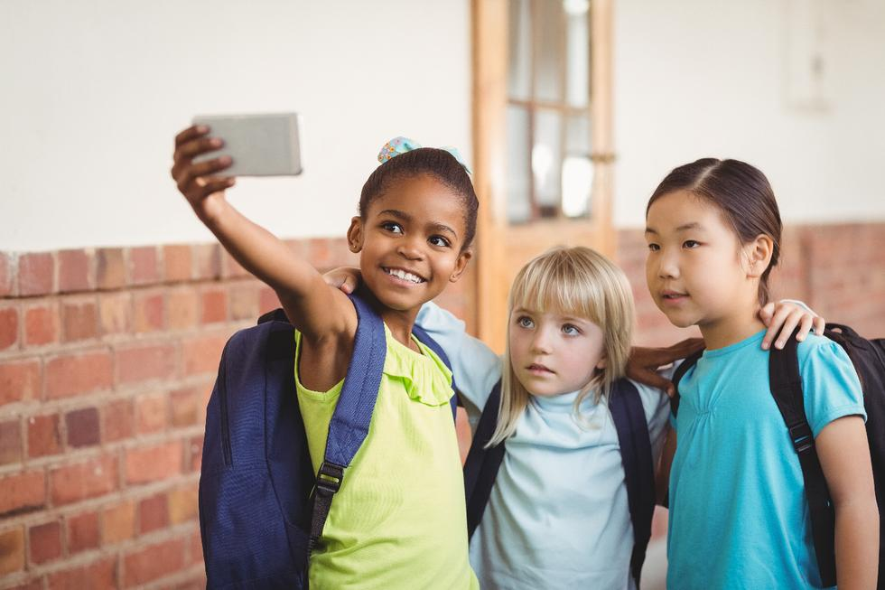
The bell rings on the last day of school. Summer is finally here!
Where will you go on vacation?
Choices Beach Amusement Park
Do So

Slide 4
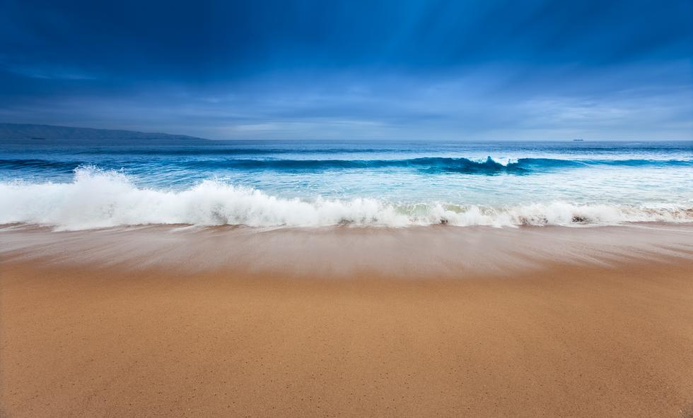
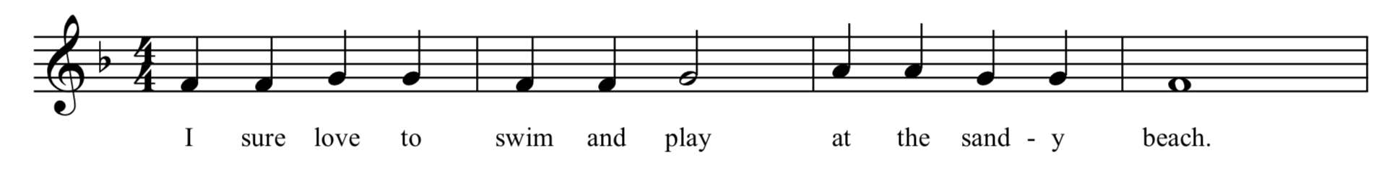
Gathering your swimsuit, towel, and sunscreen you take off for the beach. But which way should you go? The highway is faster but might have traffic. While the secret route is much longer, but sure to avoid any delays.
Choices Take highway Take secret route
Mi Do

Slide 5
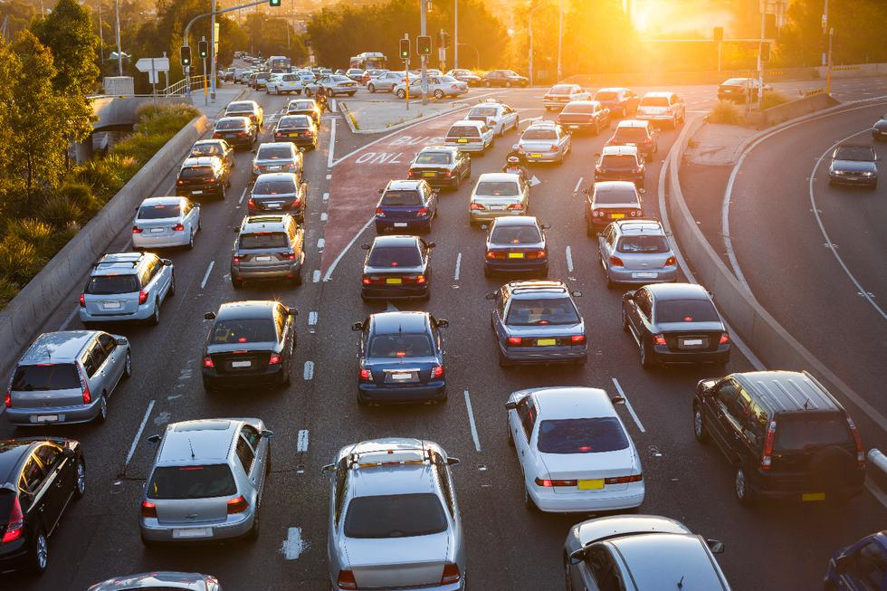
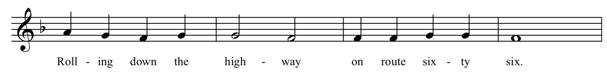
You fly down the highway making great time. You can almost smell the ocean. All of the sudden, the highway comes to a standstill. An 18-wheeler has crashed and spilled its cargo of cow manure all over the highway. You decide to either pass the time by playing a game or stop to wait it out at a rest stop.
Choices Play a game Wait at rest stop
Do So

Slide 6
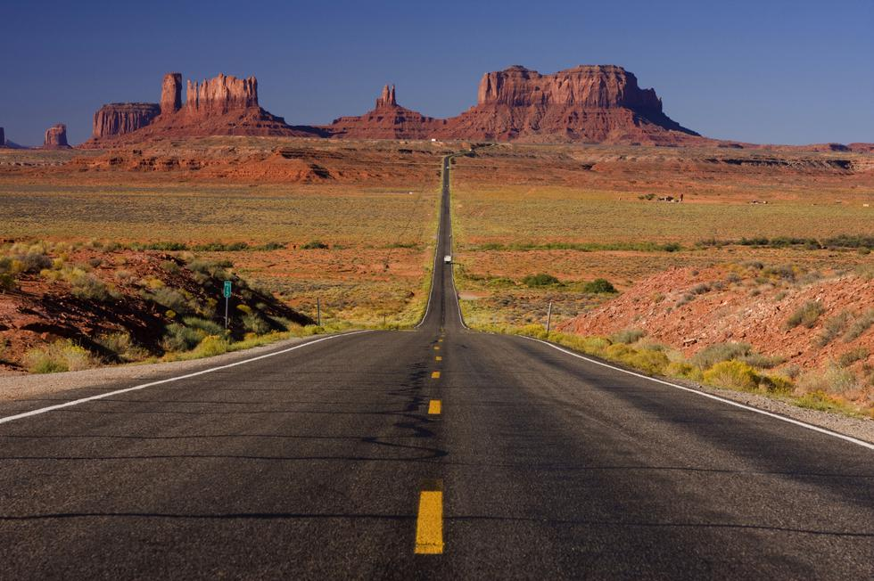
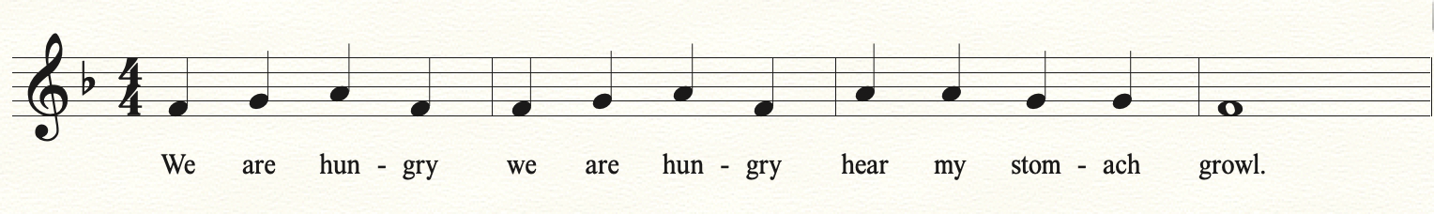
You take the secret route, but shortly into your journey you realize you didn’t pack any food, and there’s still three hours left in your trip! You can either stop for food at a rest stop or keep your mind off your hunger by watching a movie.
Choices Stop at rest stop Watch a movie
So Do

Slide 7
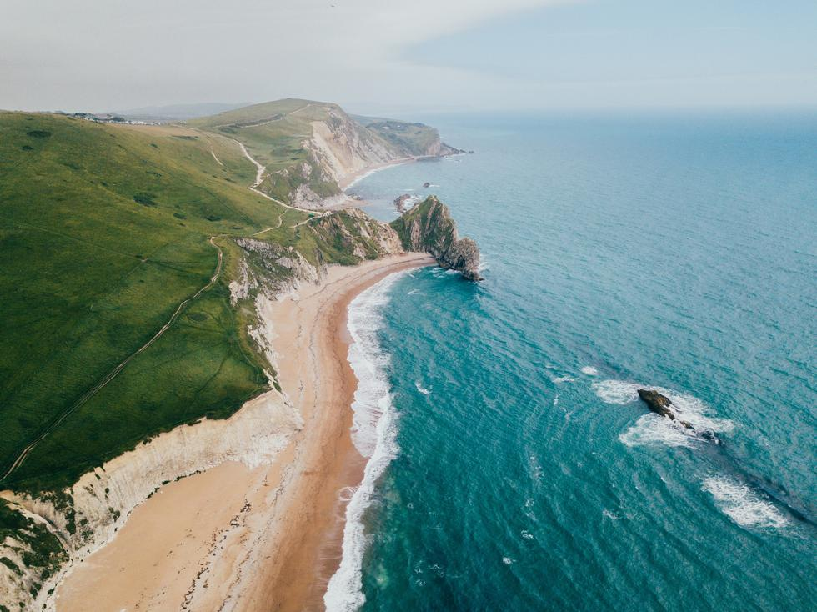
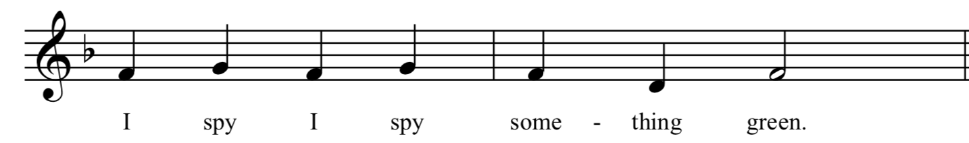
You want to play hide and go seek, but that’s a challenge in your tiny clown car. You settle for playing I spy. All of the sudden, in the distance you see it, a pristine beach. You still have to find parking. Should you go left or right?
Choices Left Right
La Do

Slide 8
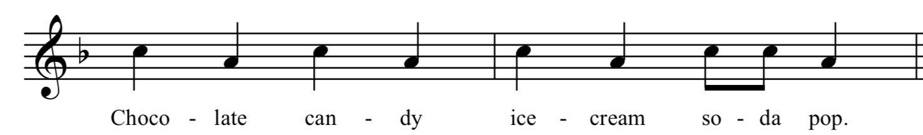
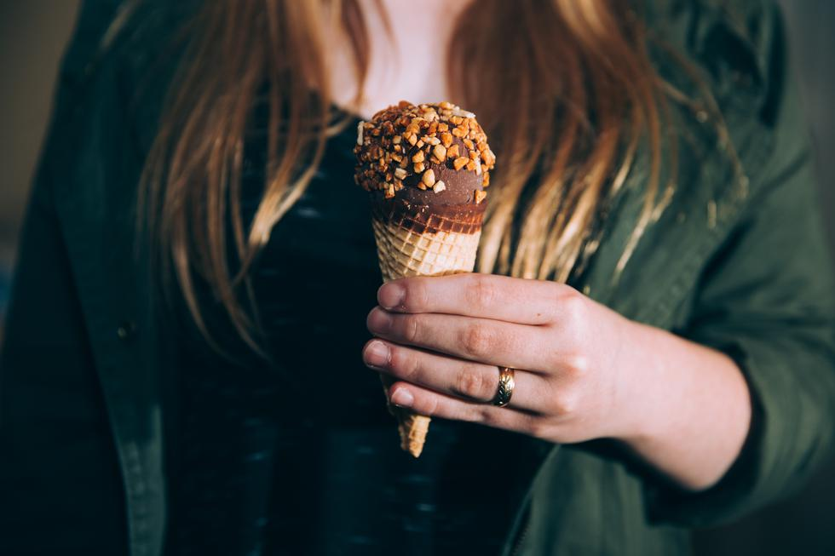
You stop and buy all your favorite candy and drinks. Ah, you feel refreshed. Next stop the beach. Which way should you go left or right?
Choices Left Right
Do Mi

Slide 9
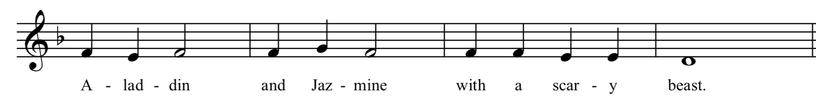
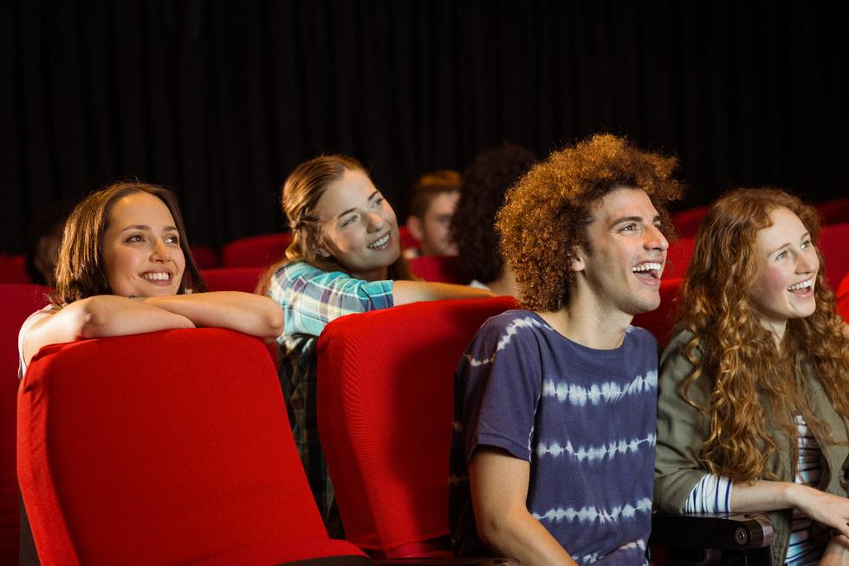
Great choice! Movies on road trips really help pass the time. But you and your siblings can’t decide which movie to watch will it be Aladdin or Beauty and the Beast?
Choices Aladdin Beauty and the Beast
Mi Do

Slide 10
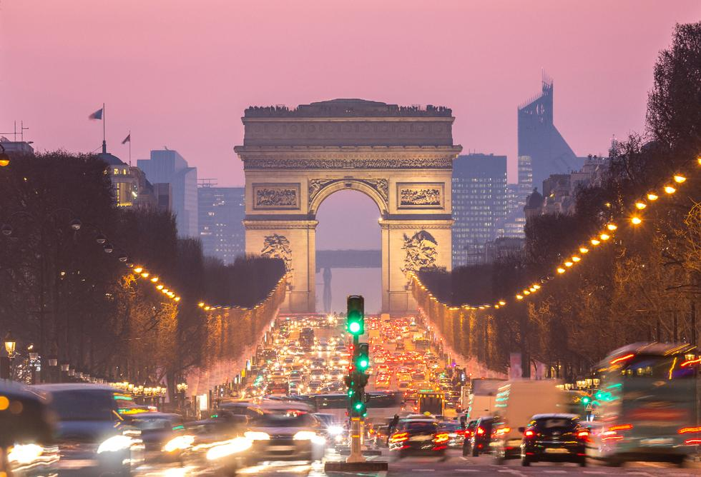
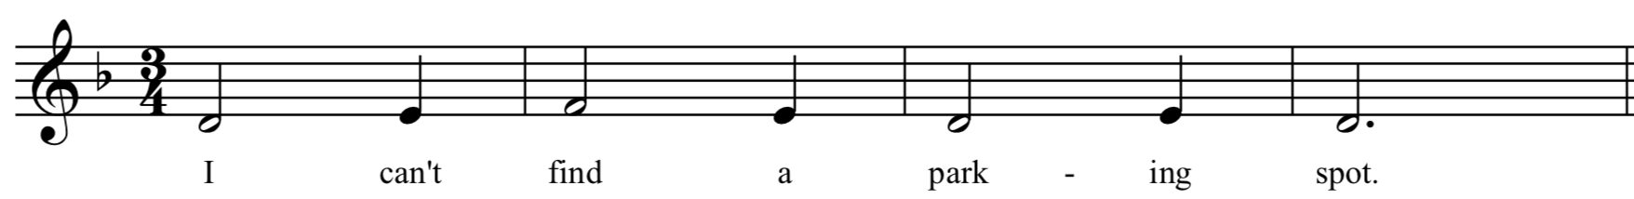
You turn left, drive up and down the beach for hours, but there is not a parking spot in sight. Becoming extremely frustrated you decide to turn around and head to the city swimming pool back in your hometown.
Your Journey End’s Here

Slide 11
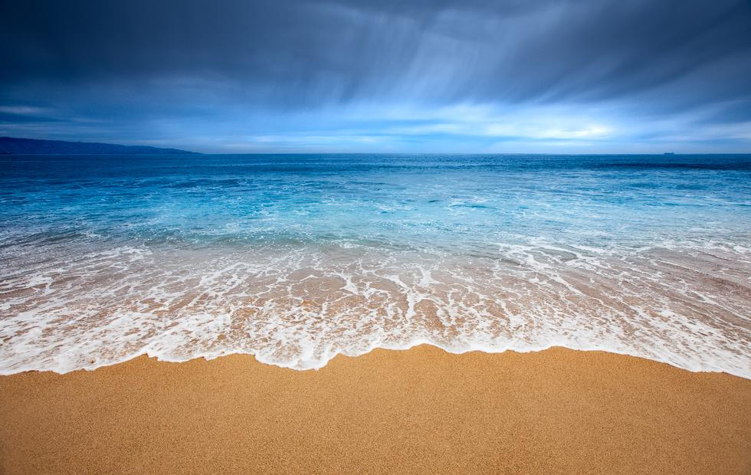
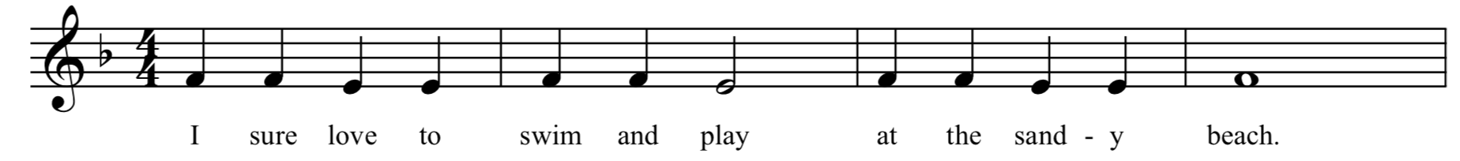
Great choice! It is a beautiful day, you pull right up to the beach, park the car, but before you can get in the water, you must first sing in two parts. Then you can play all day!
Part 1
Part 2

Slide 12
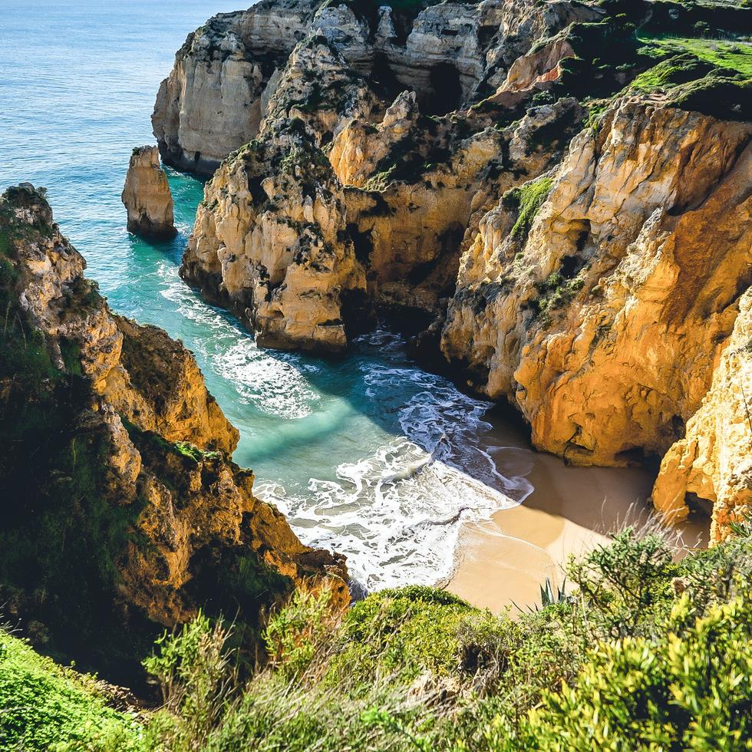
You reach the top of the final hill. Looking out you see water as far as the eye can see. It was a great day to go to the beach! In order to stay at the beach longer, you must first sing in two parts.
Part 1
Part 2

Slide 13
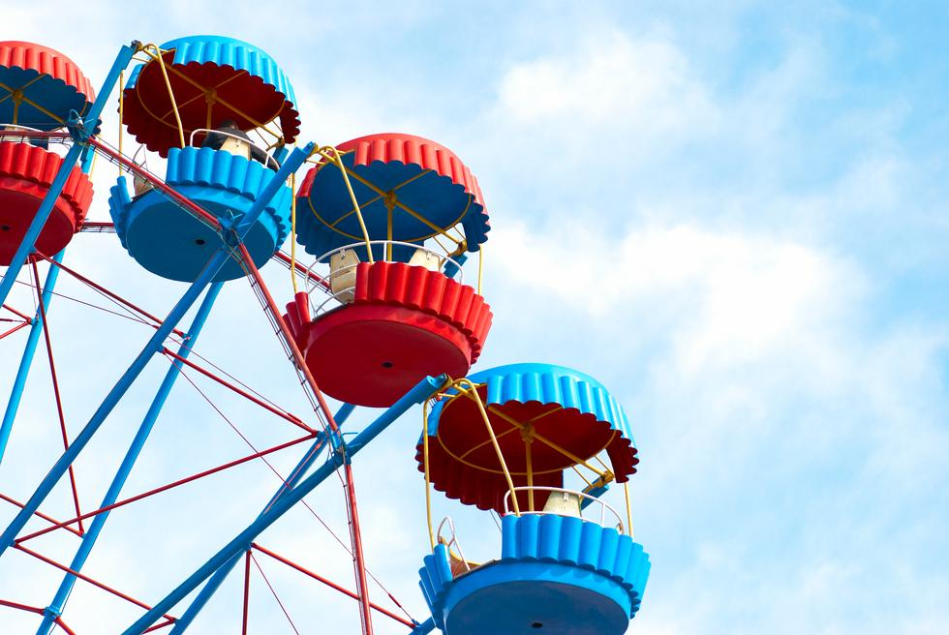
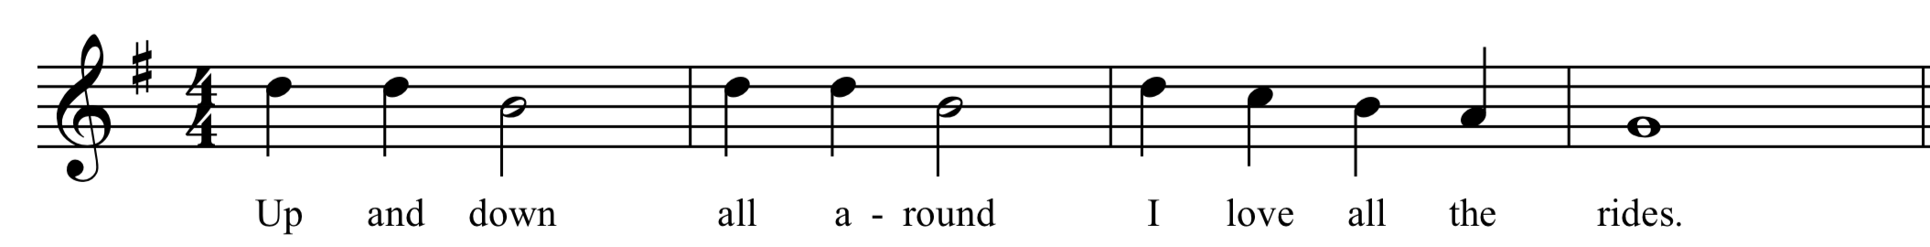
Excited about the amusement park rides, you gather your belongings and start driving. Which way should you go Highway 10 or Route 66?
Choices Highway 10 Route 66
Do La

Slide 14
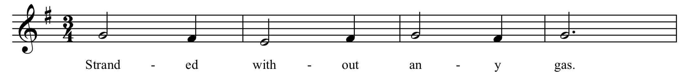
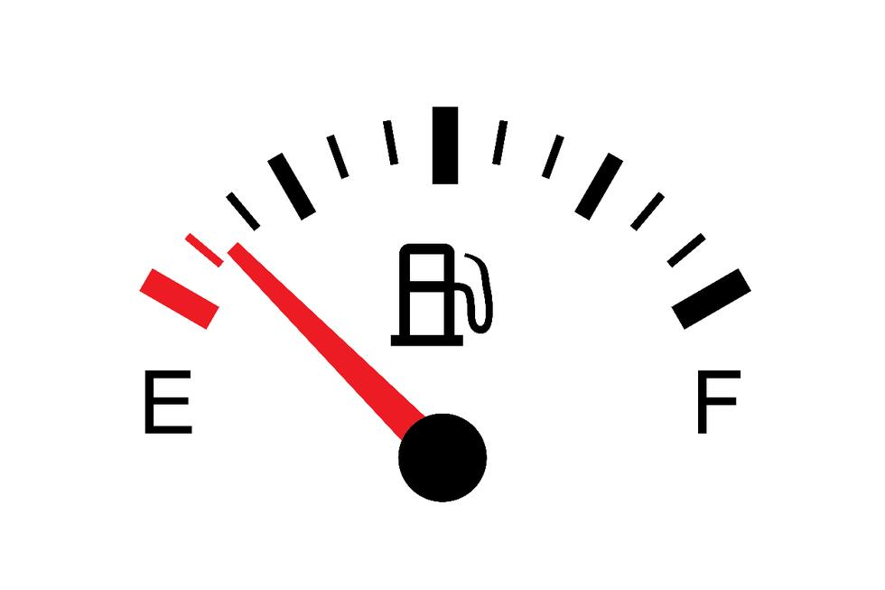
You fly down Highway 10 making great time. Suddenly you realize that in your excitement to get to the park you forgot to fill up with gas. Stranded on the side of the road what should you do? Walk to the nearest gas station or call for assistance?
Choices Walk Call for help
Do La

Slide 15
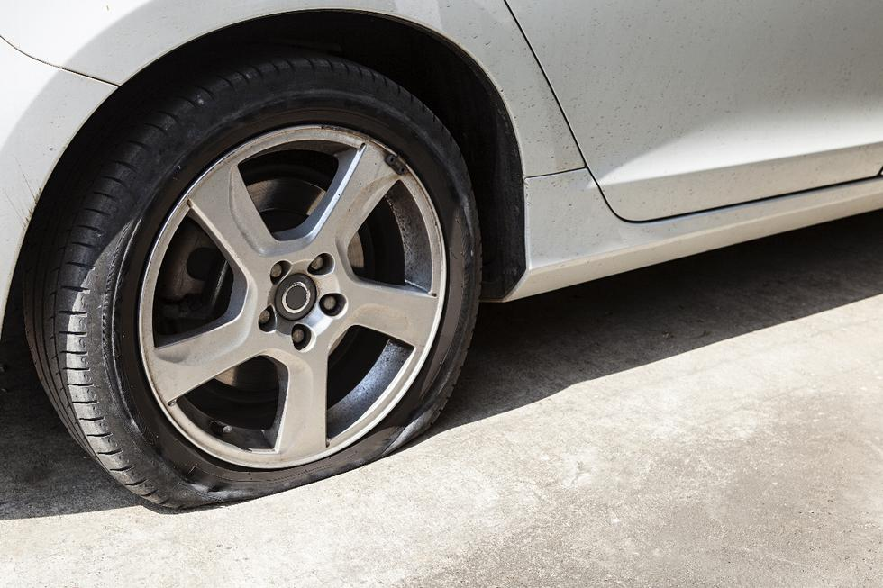
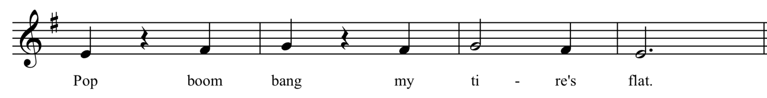
You cruise down Route 66. Out of nowhere you hear a loud pop. Your car hobbles along with a flat tire. You can either call for assistance, or you can fix it yourself.
Choices Call for help Fix it yourself
La Do

Slide 16
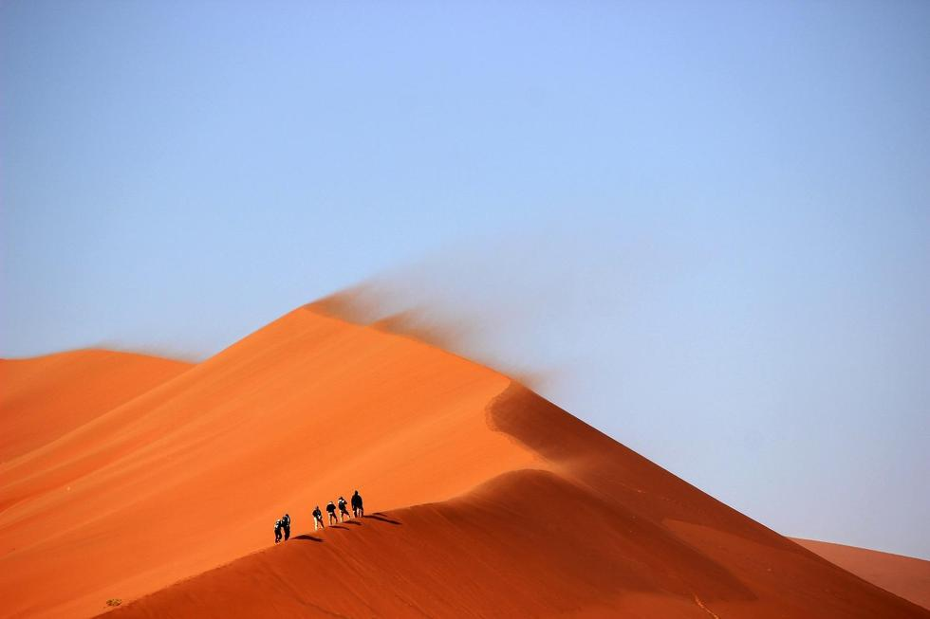
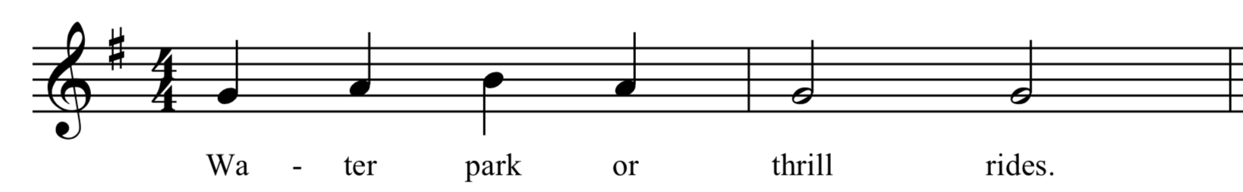
You start walking in the blazing 95-degree sun. Thankfully the gas station is only a half mile away. You make it back to your car and start driving again. However, the walk was so draining you wonder if going to the water park might be a better choice.
Choices Water park Amusement park
Do So

Slide 17
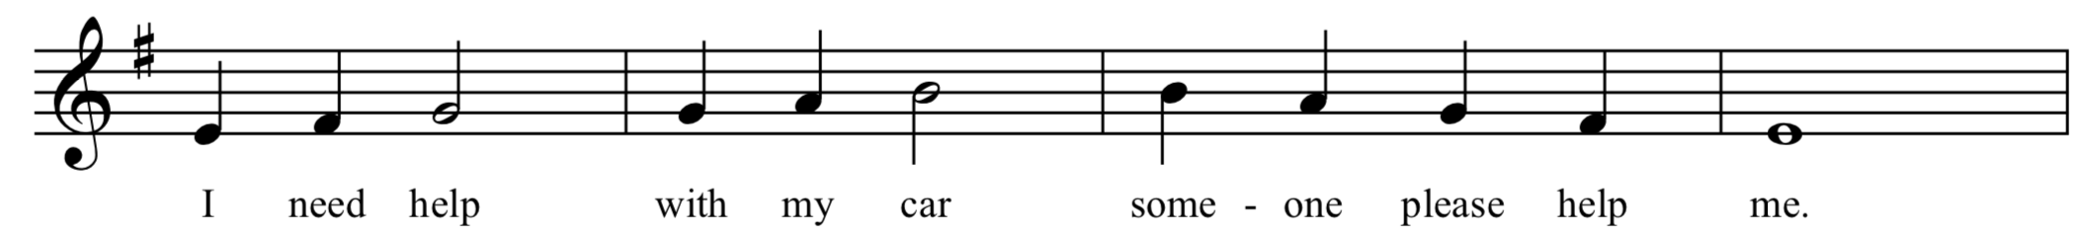
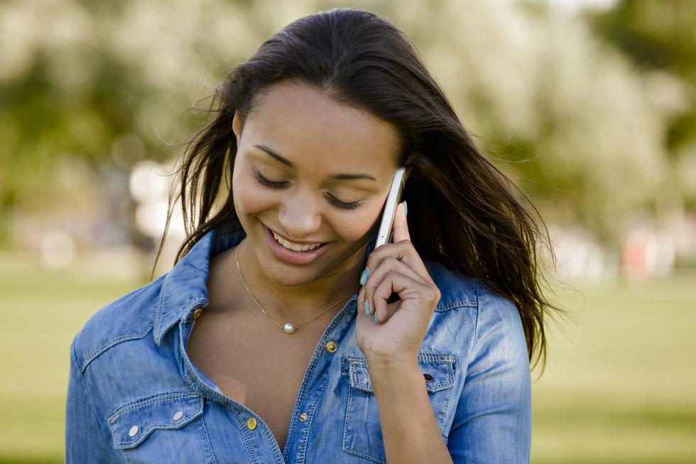
You call for assistance, but help is two hours away. You wait in complete boredom. . . finally help arrives. As you return on your journey do you turn left or right?
Choices Left Right
Do So

Slide 18
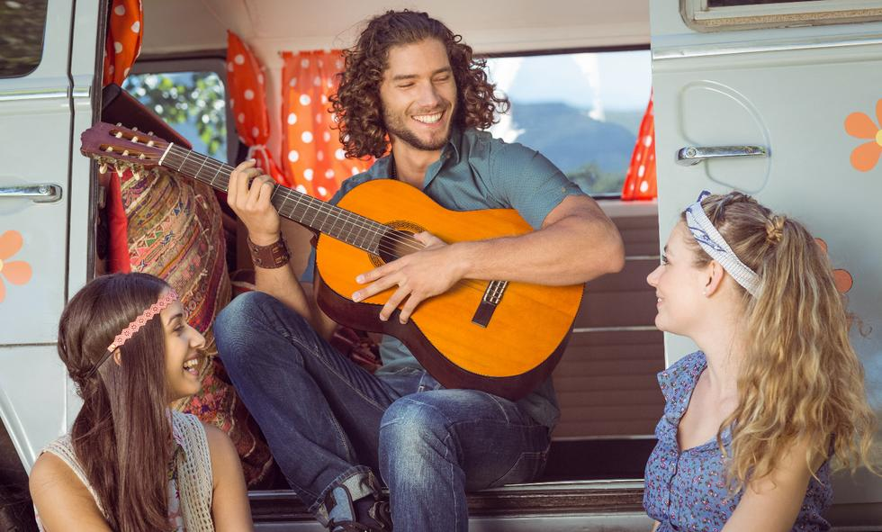
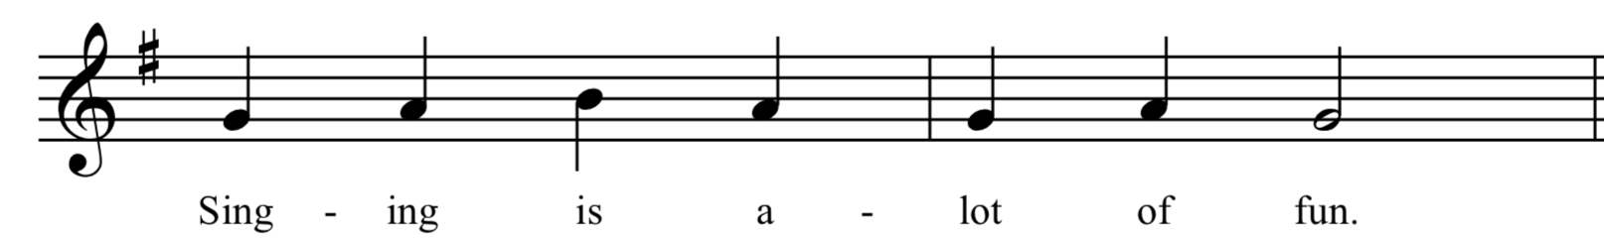
While fixing your tire you pass the time by singing along with the radio. As you start back on your journey your younger sibling wants to watch a movie. Do you want to continue to sing or watch a movie?
Choices Watch a movie continue to sing
So Do

Slide 19
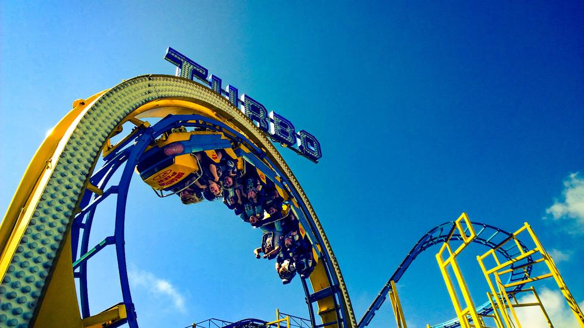
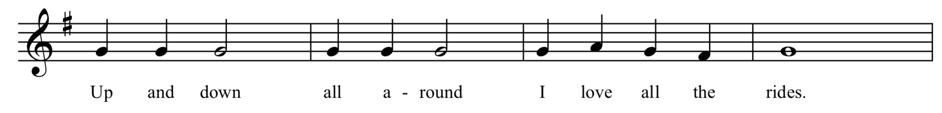
The drive drags on forever. Will you ever get there? Suddenly, something catches your eye over the top of the trees. You spot it, your favorite roller coaster is towering over the park. You can hardly contain your excitement, you’re finally there! Go to the front of the line by singing in two parts.
Part 1
Part 2

Slide 20
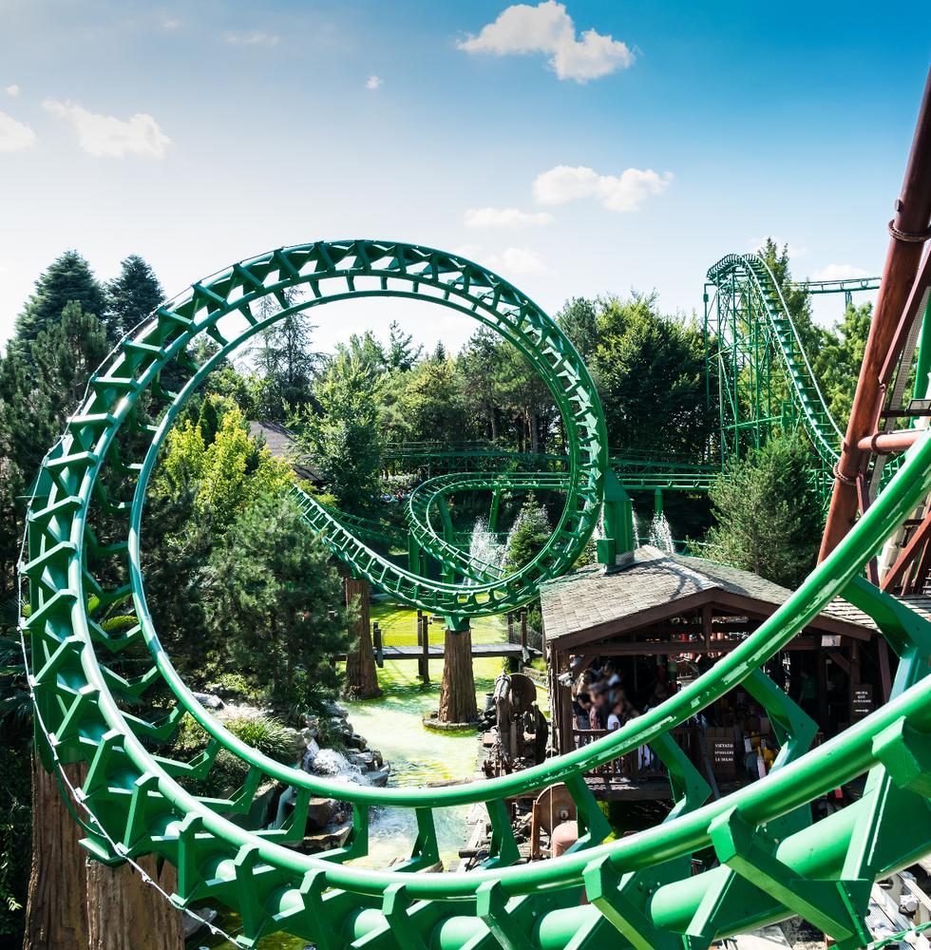
You finally reach the amusement park! To your surprise, the park is almost entirely empty. There are no lines for any of the rides. What great luck you have!
Part 1
Part 2

Slide 21
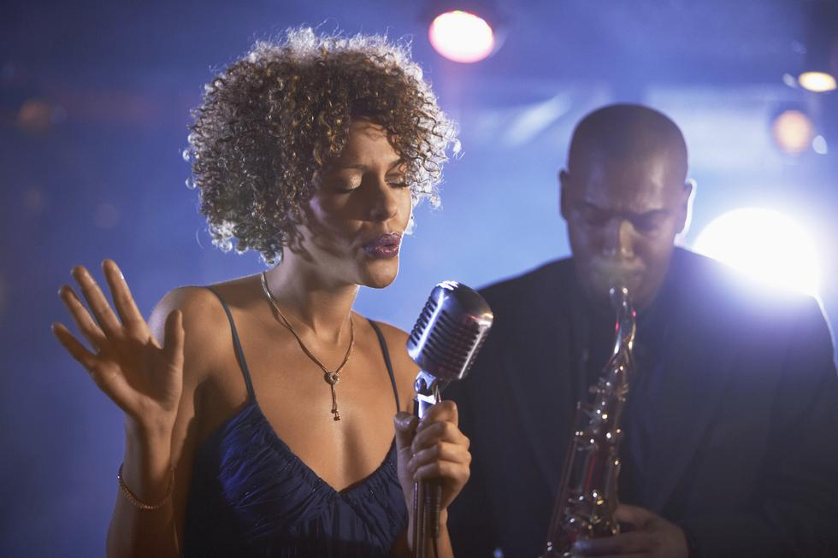
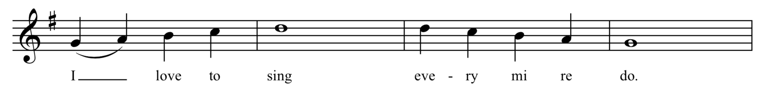
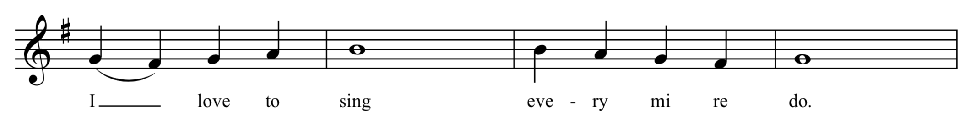
You have enjoyed singing so much you decide to head to the American Idol auditions instead of the amusement park. All your favorite stars are there, what a show!
You receive front row tickets if you sing in two parts.
Part 1
Part 2

Slide 22
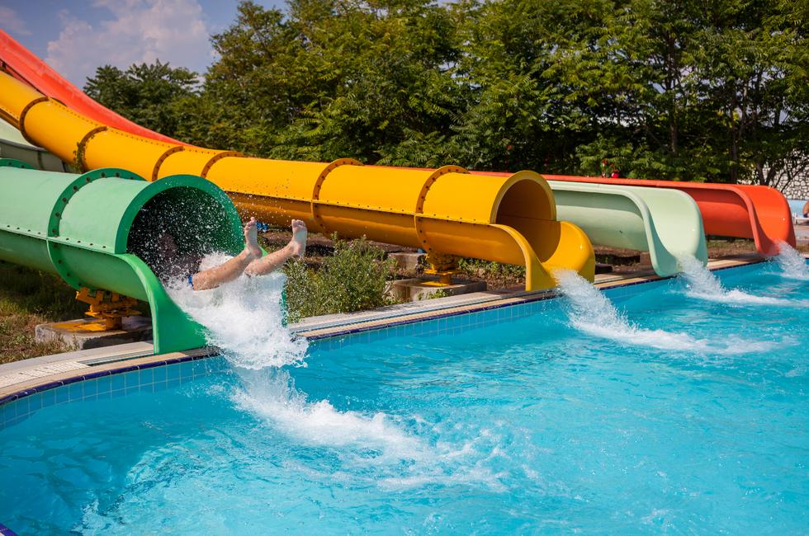
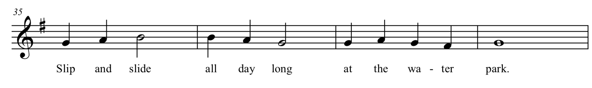
You run into the waterpark and jump straight in the water. After all the travel disasters from today, this turned out to be the perfect choice.

