Slide 1
Sight-Reading Adventures
At the Mall
Suggested Age- 7th-8th Grade Treble
Range- S, L, T, D, R, M, F, S (tonic triad skips)
Two-part, Soprano/Alto exercises
by Micah Bland

Slide 2
Instructions
Upon completing the sight-reading exercise, read the text. Students then select which path to take. Students vote for the path by displaying the corresponding Curwen hand sign and singing the designated pitch.
Click the solfege text of winning path for a direct link to the next slide.
Students can sight read using any of the following combinations: chant, sing on solfege, or sing text.
Suggested combinations include
  First reading all sing solfege, second reading all sing text.
  Teacher sings text, students sing solfege.
  Half of the group sings text other half sings solfege.

Slide 3
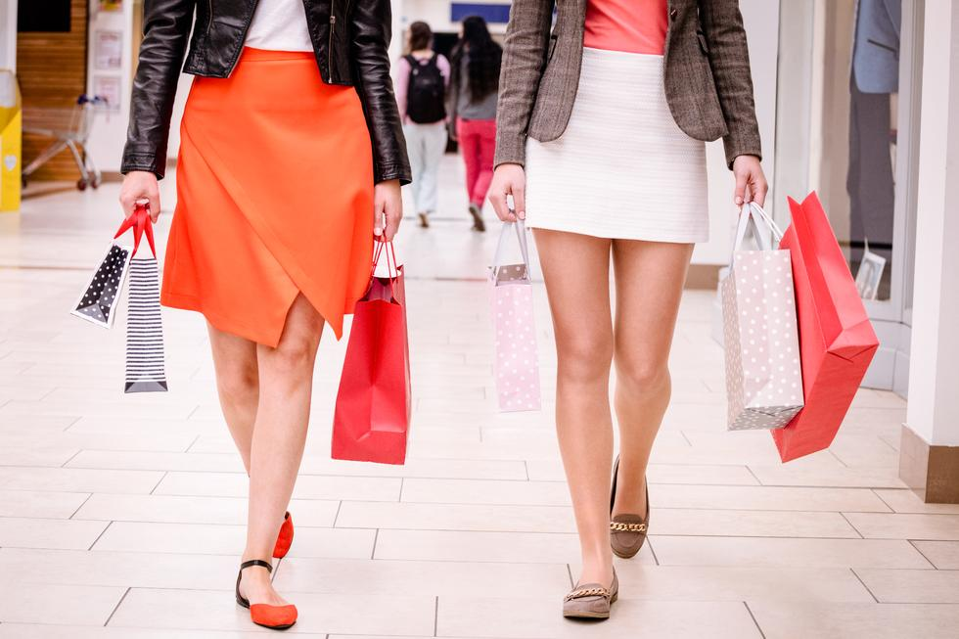
You want to go to the mall with your friends, but who will drive you? Your uncool older sister can take you now, but your friend Samantha can drive you in an hour, after she finishes her homework.
Choices Older Sister Friend Samantha
Do Mi

Slide 4
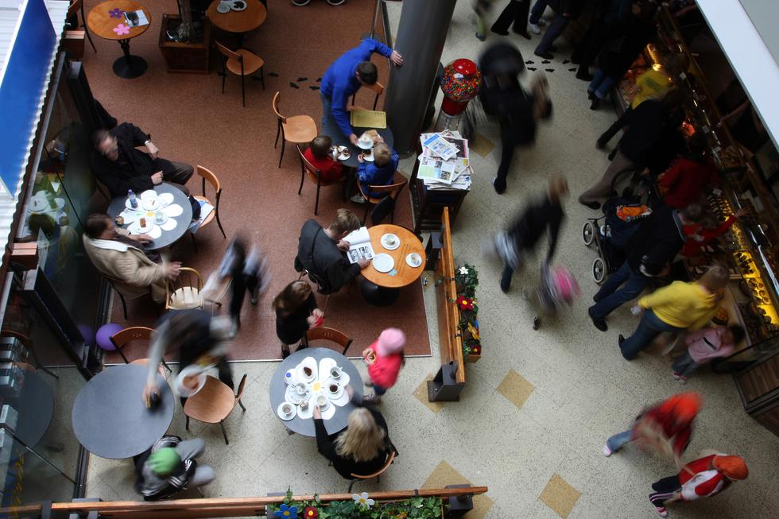
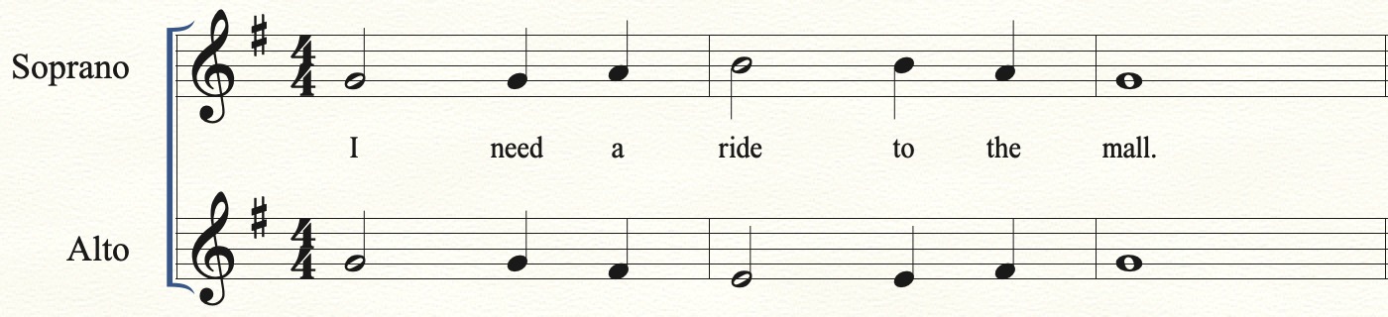
Your older sister drives you to the mall. You’re surprised, she lets you control the radio. Maybe she’s not so uncool after all. You meet up with your friends. What should you do first? Go eat at the food court, or go to your favorite store Forever 21?
Choices Food Court Forever 21
Mi So

Slide 5
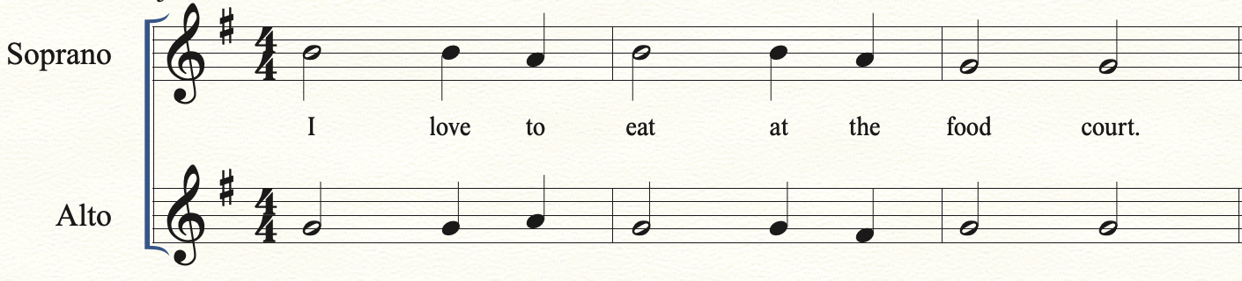
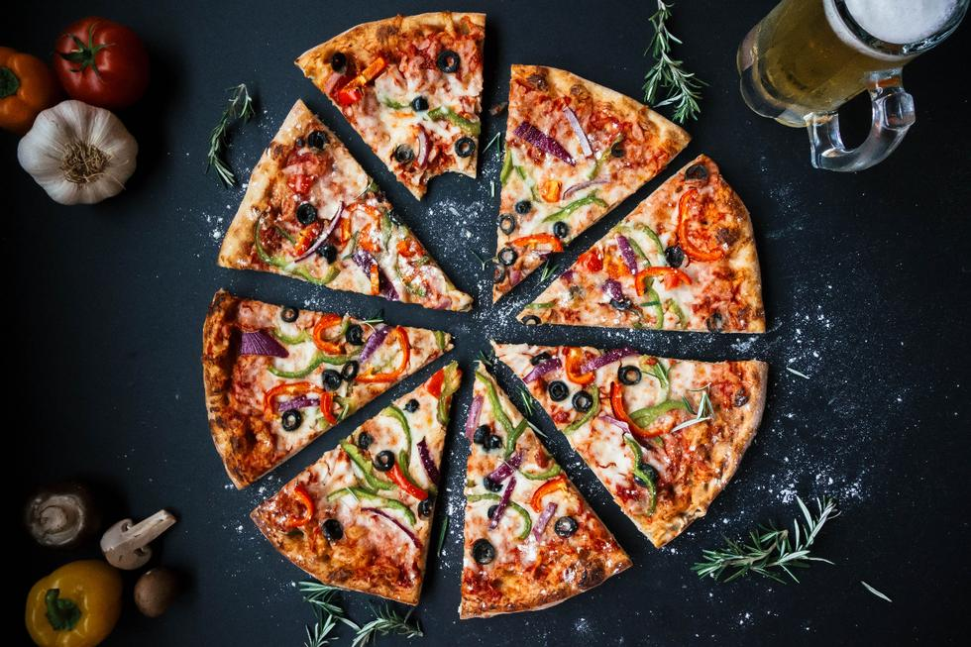
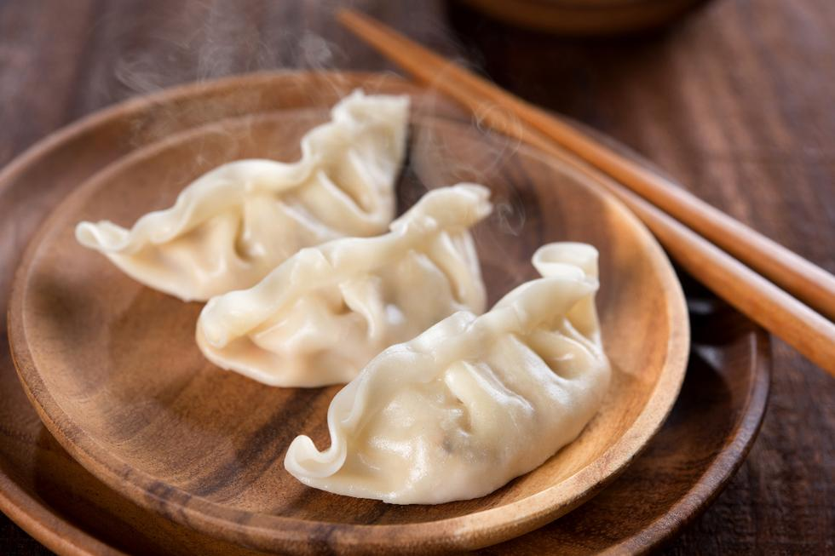
You get to the food court. So many choices! Do you want Chinese food or Pizza?
Choices Chinese Food Pizza
So Do

Slide 6
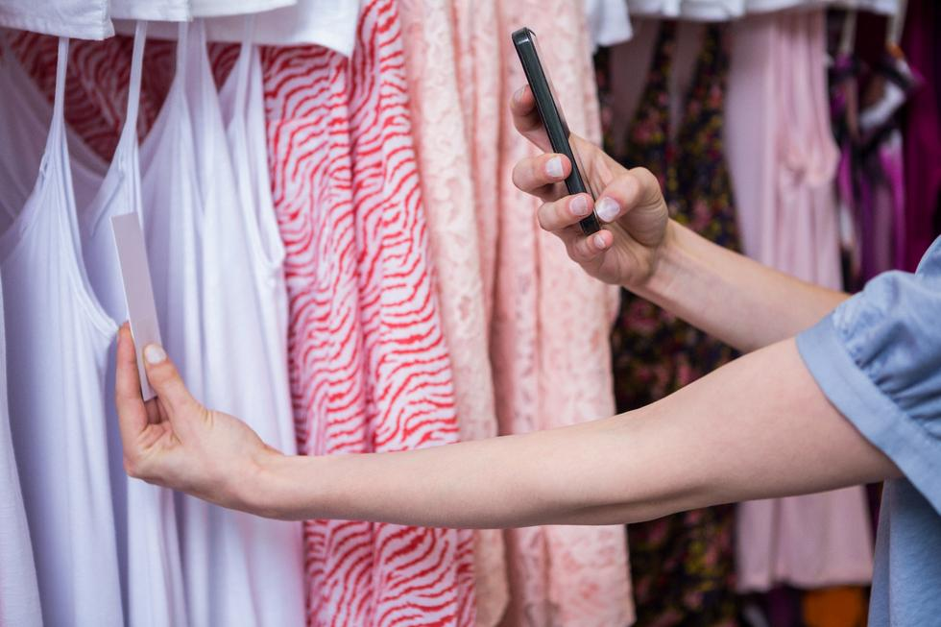
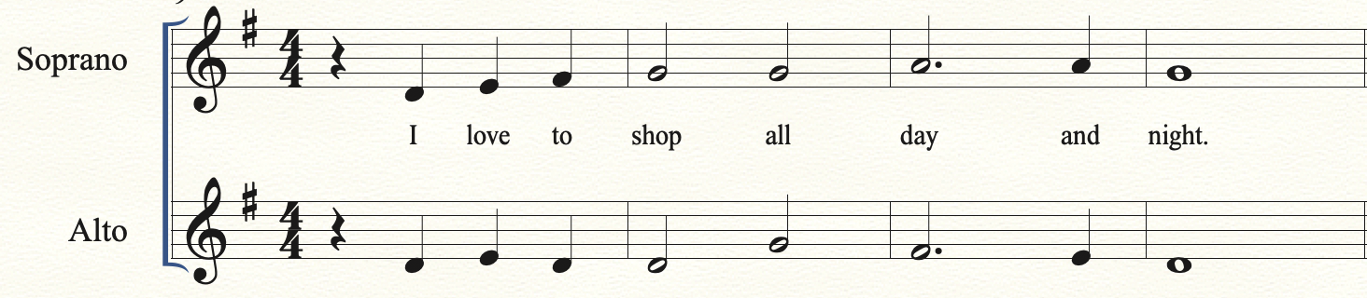
You make your way to Forever 21. It’s your lucky day, the sign on the door says 40% off entire store. You find so much that you like, but since you’re on a budget you can only get one of them. Will it be that beautiful skirt or that fantastic tank top?
Choices Skirt Tank Top
La Do

Slide 7
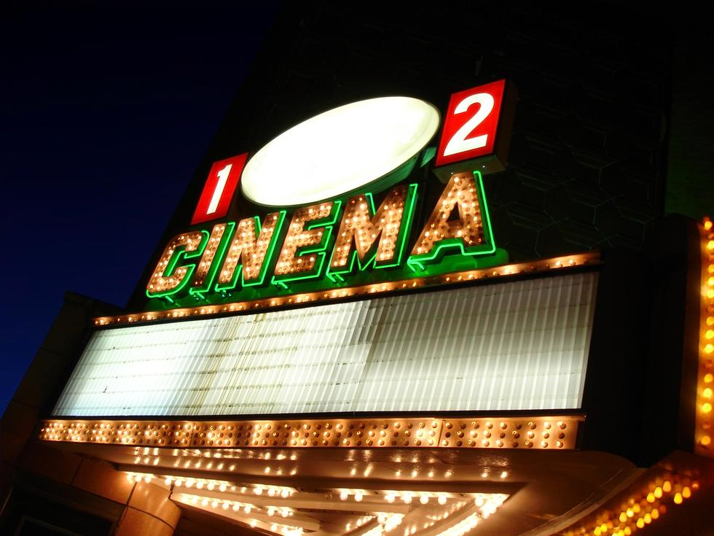
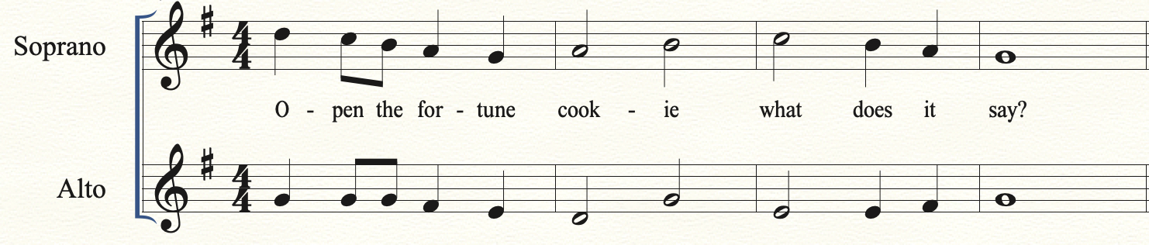
That Chinese food was great! On your way out of the food court you notice your favorite movie is now in theatres. Unfortunately, your friends didn’t bring enough money for the movies. Do you go to the movies without them or continue shopping?
Choices Movies Continue Shopping
La Do

Slide 8
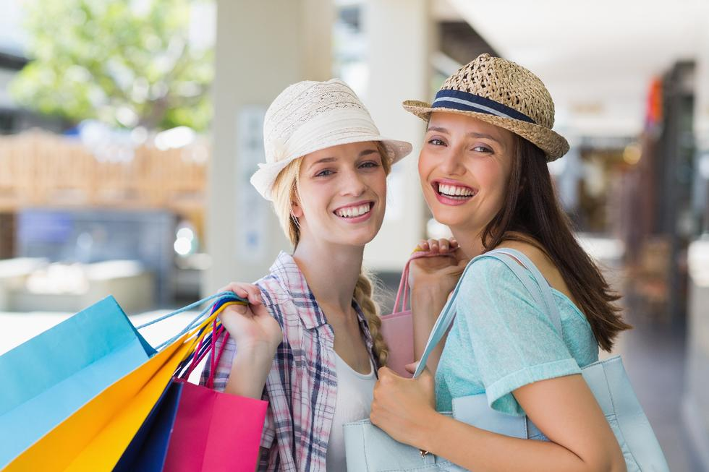
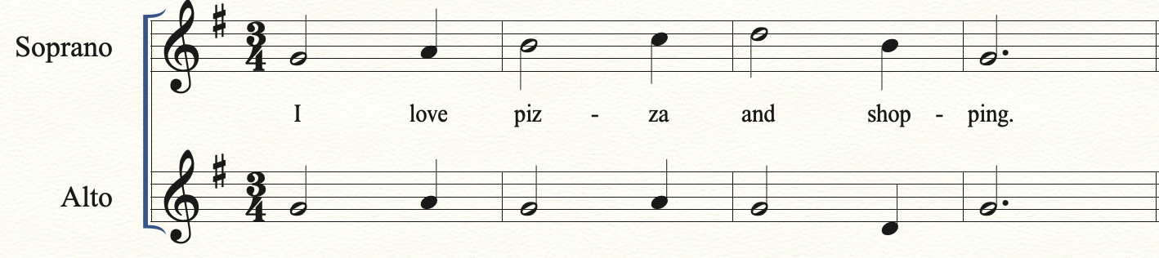
Pizza Yum! You and your friends return to shopping. Which store should you go to first American Eagle or Old Navy?
Choices American Eagle Old Navy
Do La

Slide 9
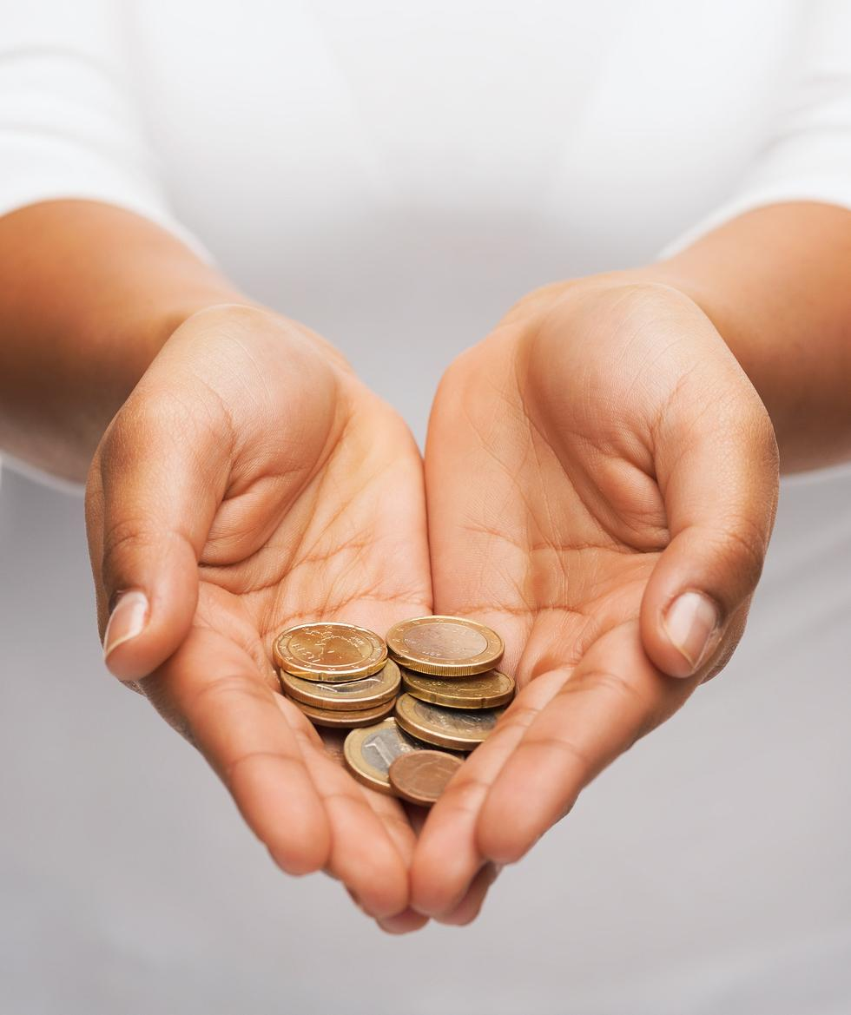
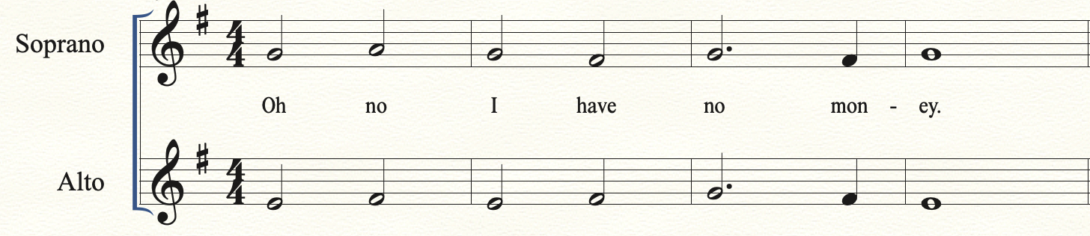
You get the skirt, but oh no! You realize you were in such a rush to get to the mall that you forgot your money. Do you call your dad to bring you money or do you put the skirt back and hope it’s there tomorrow?
Choices Call Dad Return tomorrow
So Do

Slide 10
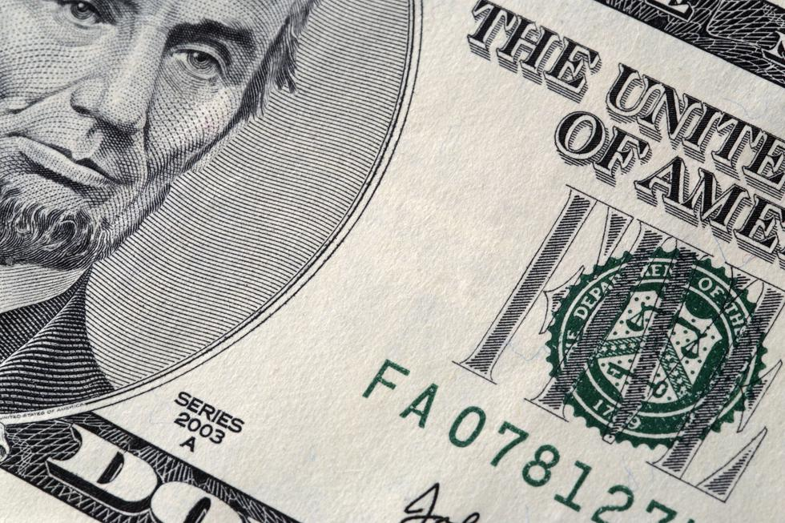
You try on the tank top. It fits perfectly! But oh no! You realize you were in such a rush to get to the mall that you forgot your money. Do you call your dad to bring you money, or do you put the skirt back and hope it’s there tomorrow?
Choices Call Dad Return Tomorrow
So Do

Slide 11
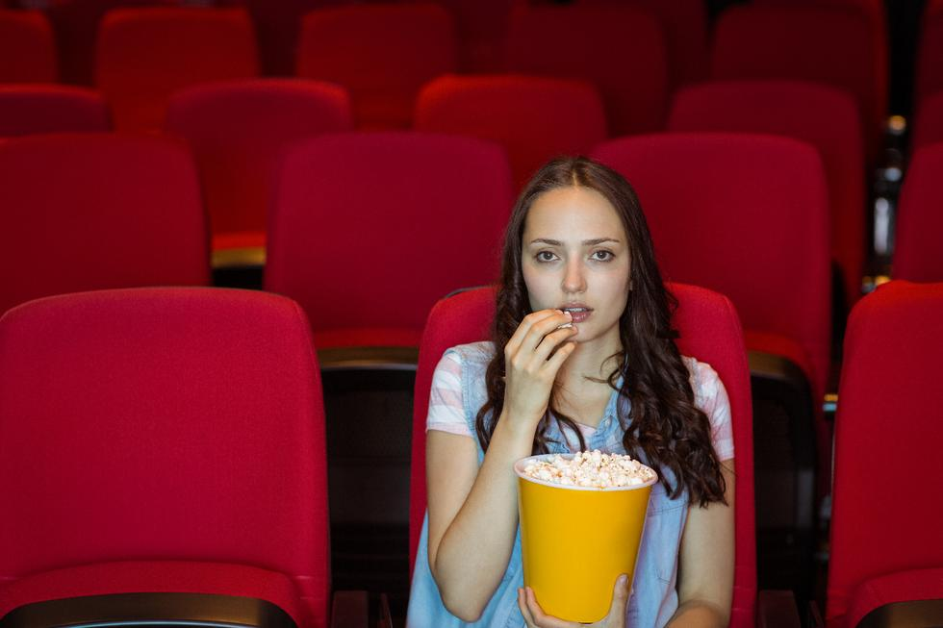
You go to the movies without your friends. It was a great movie, but while leaving you check your phone and see your friends sent you a picture. It just so happened that Ariana Grande was shopping in the store they went to, and they got to meet her! What a bummer, you missed out!

Slide 12
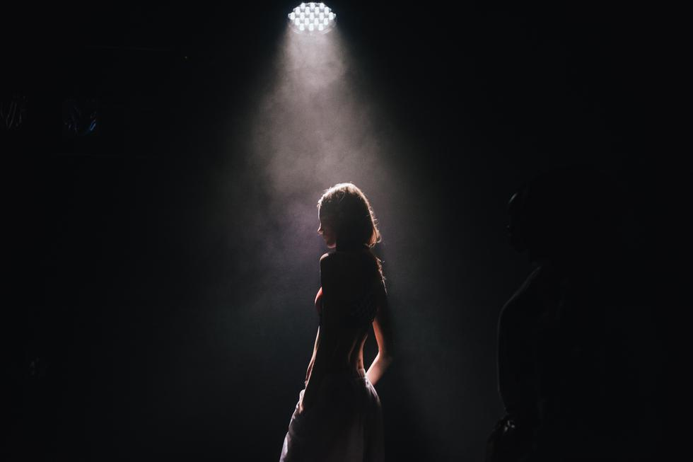
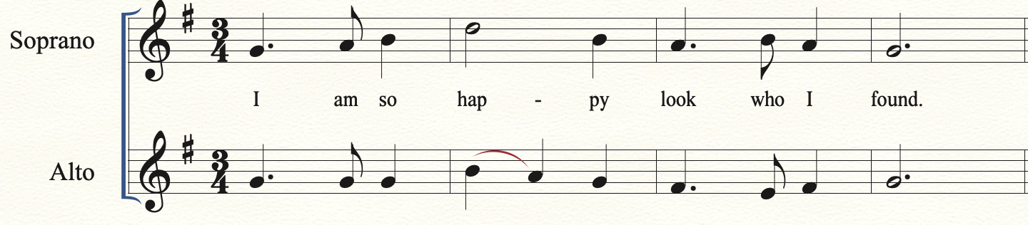
You continue shopping. You walk into a really expensive store just to browse, and you see her. . . It’s Ariana Grande! You can’t believe it. You calmly walk over to her and ask for a picture. She says “yes, I’d be happy to.” What a great day!

Slide 13
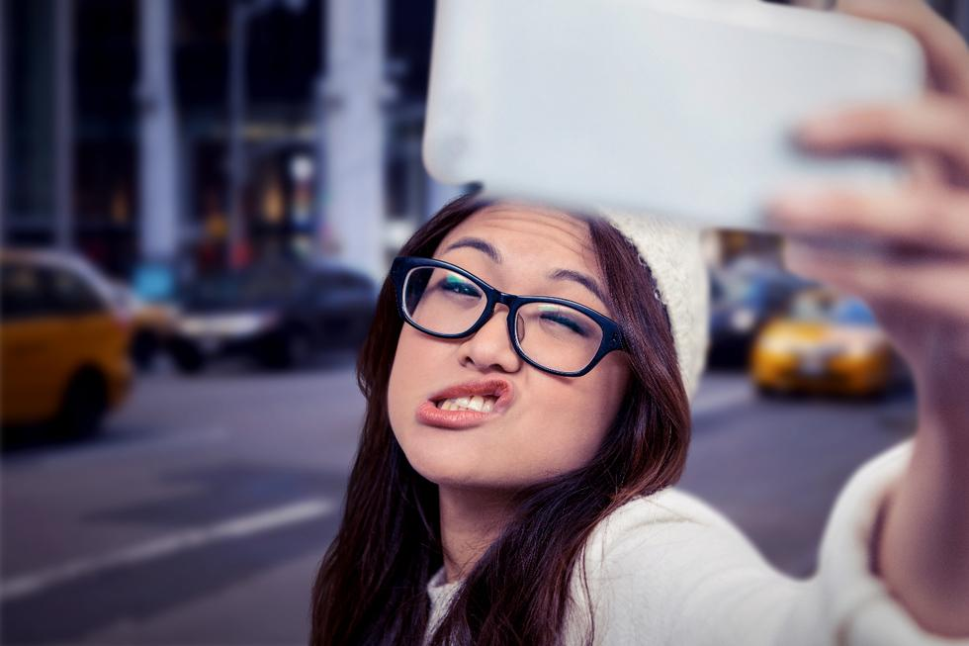
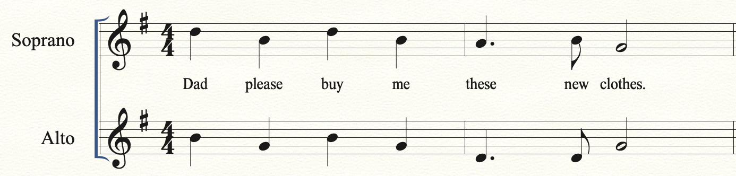
You Facetime your dad for the money. You put on your best pleading face and say, “Daddy, can you bring me some money for this skirt.” In response your dad says, “let me see the skirt.” Hopeful, you hold it up to show him. To your disappointment he says, ”No way, that skirt is too short!”

Slide 14

You Facetime your dad for the money. You put on your best pleading face and say, “Daddy, there’s this really cute tank top.” In response your dad says, “Get a job and you can buy all the clothes you want!”

Slide 15
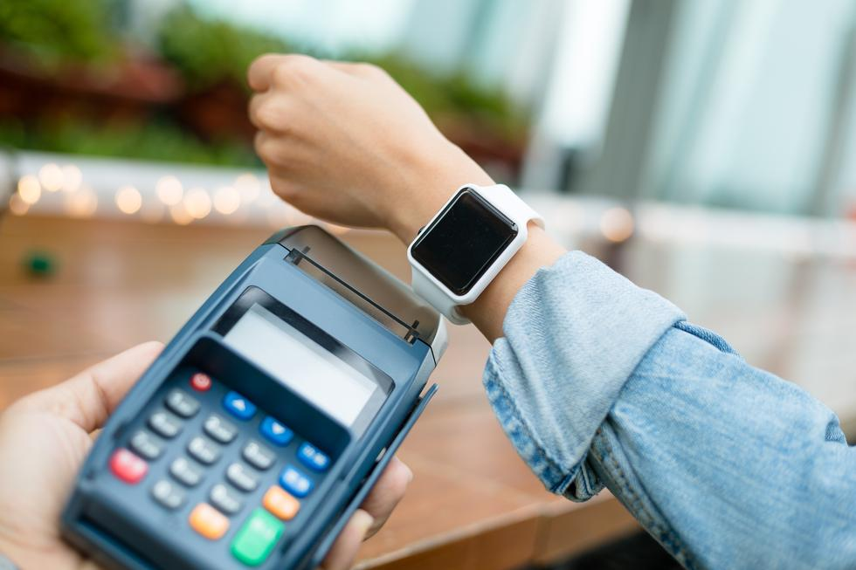
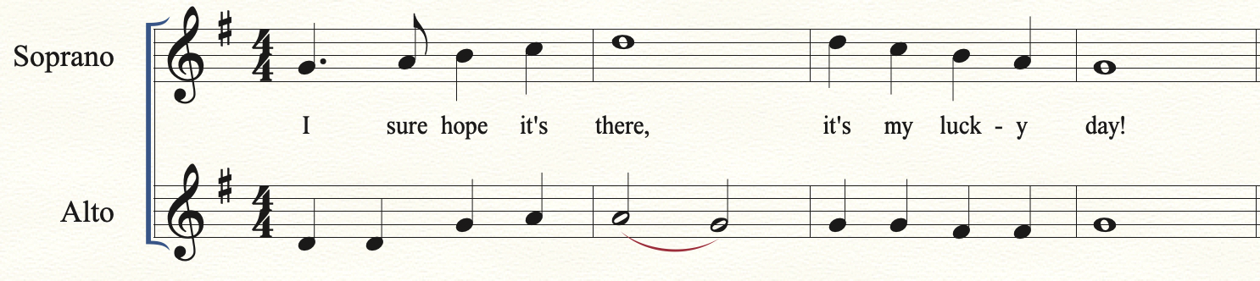
You return the next day for the item. It’s your lucky day! Not only is it still there, but its an extra $10 dollars off. Patience really pays off.

Slide 16
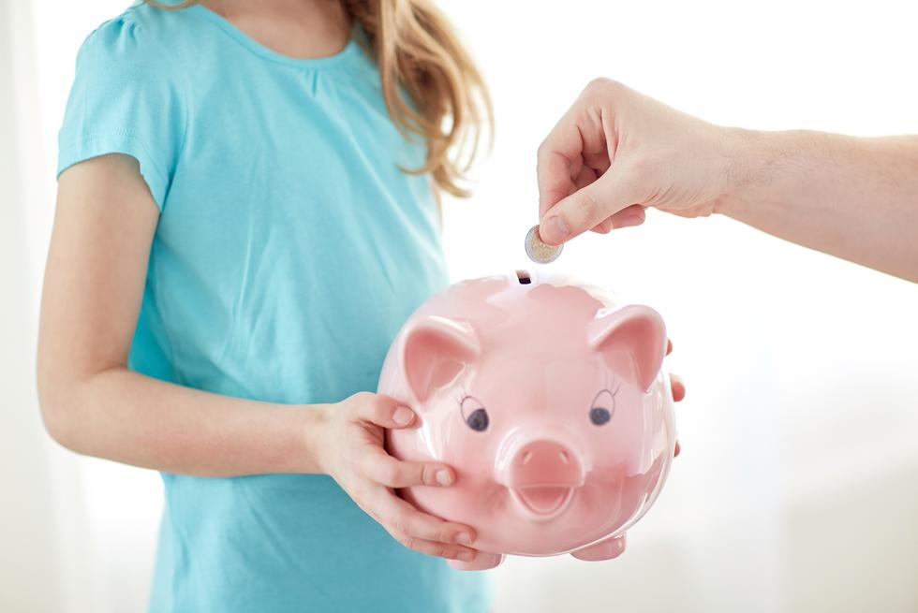
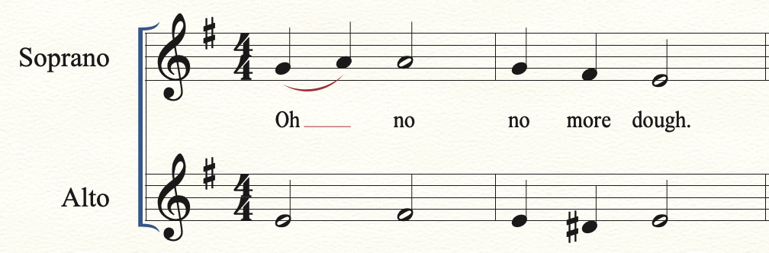
You head for Old Navy, but decide to check how much money you have left. Oh no! That pizza was more expensive than you thought, you only have $3 left. That amount won’t be able to buy anything. You decide to make the most of it, and continue hanging out with your friends.

Slide 17
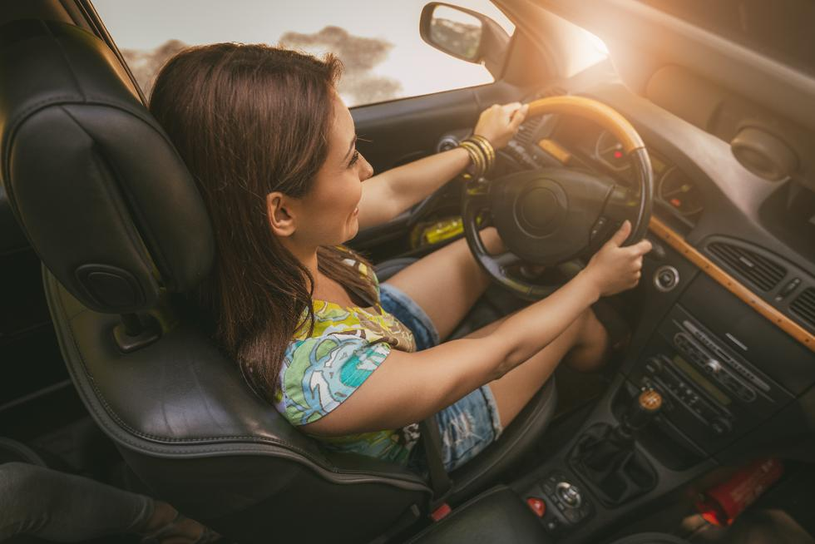
An hour and a half later your friend finally picks you up. Her mom wouldn’t let her leave until she cleaned the dishes. You meet up with your other friends. Where should you go first your favorite clothing or make-up store?
Choices Clothing Store Make-up store
Do Mi

Slide 18
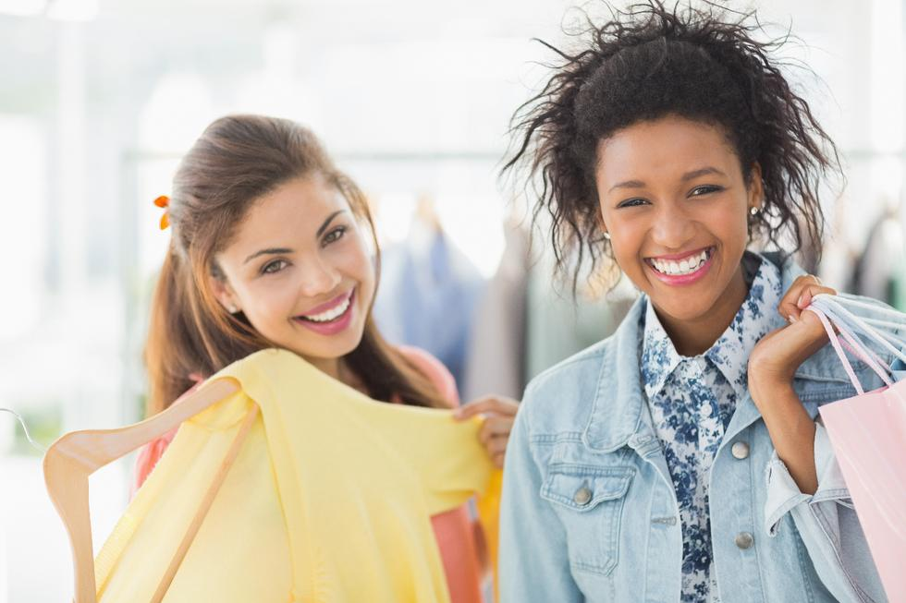
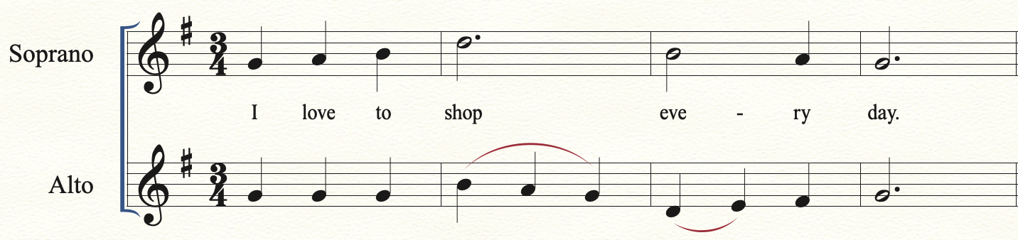
You walk into your favorite clothing store. Good news, everything is an extra 20% off today! You find two items that you like, but only have enough money to buy one. Which will it be, a new purse or a pair of shorts?
Choices Purse Shorts
Do So

Slide 19
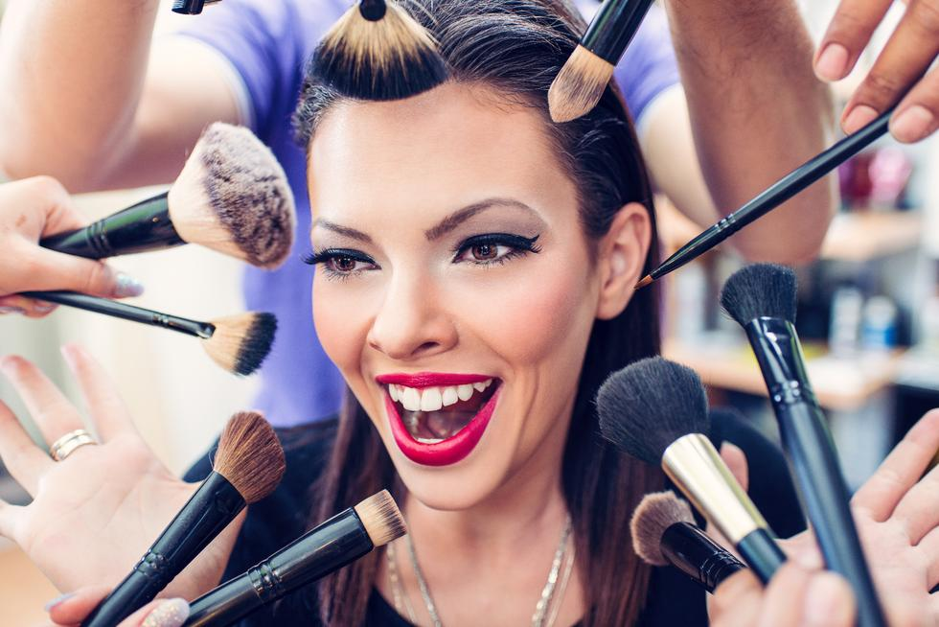
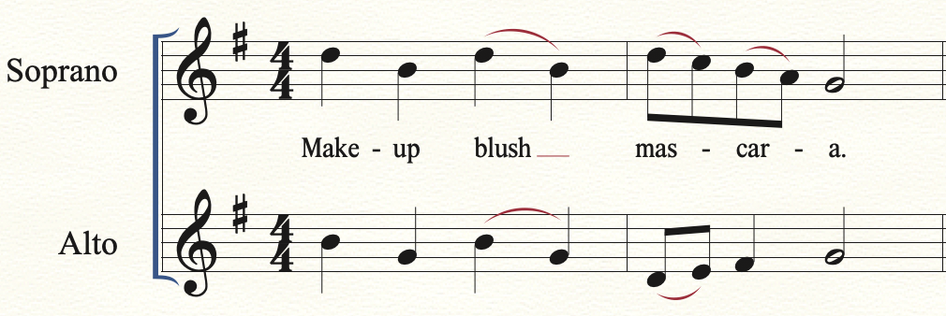
You walk into your favorite make-up store and start to browse. They have so much great stuff, but it’s all so expensive. Do you buy blush or mascara?
Choices Blush Mascara
Do Mi

Slide 20
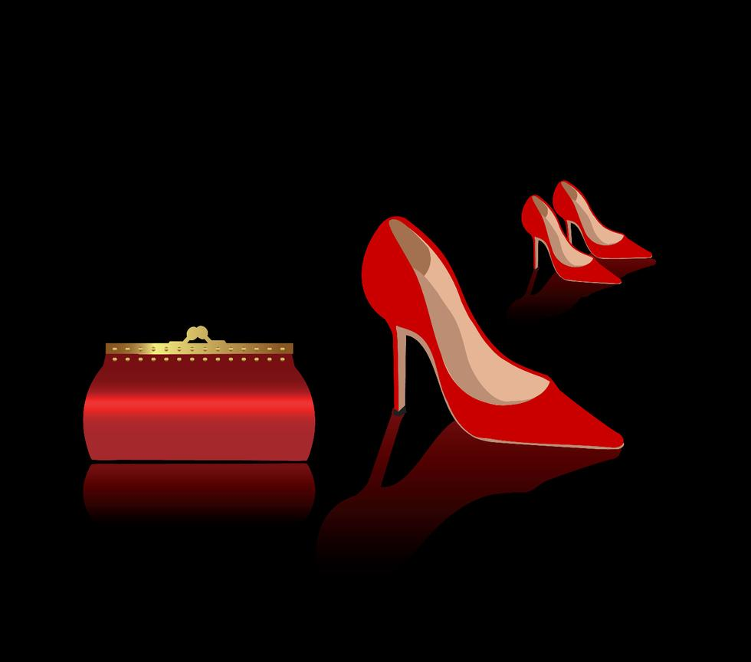
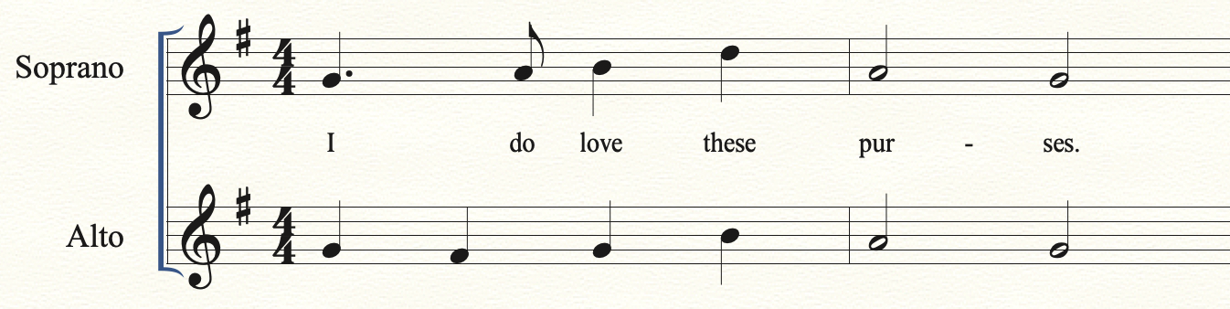
You pick up the red purse. It will go great with the shoes that you’re already wearing, but you could really use a different color. Do you keep the red, or buy the always fashionable black purse?
Choices Red Purse Black Purse
Do Mi

Slide 21
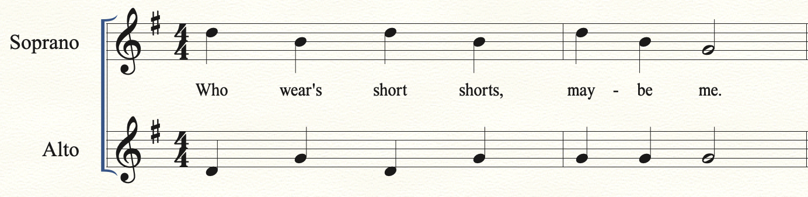
You pick up the pair of shorts, but which style should you get? You could get the dad approved mid thigh length, or the much shorter version.
Choices Mid Thigh Shorts Short Shorts
Mi Do

Slide 22
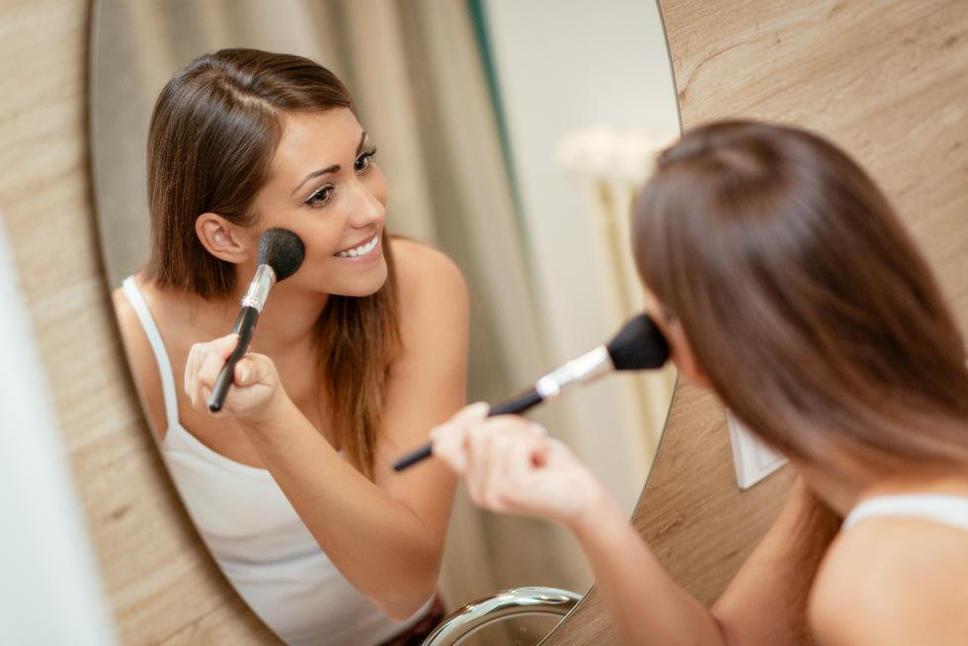
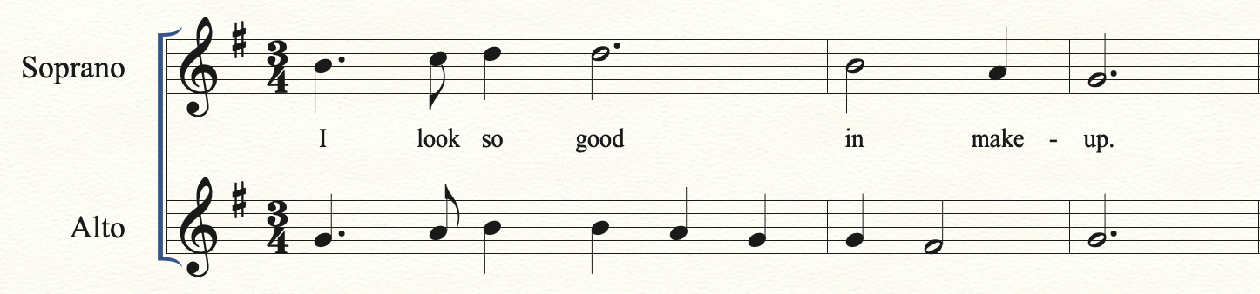
You test out some of the blush. Your friends say, “Wow! You look good.” But which brand should you buy, Nars or Chanel?
Choices Nars Chanel
Do Mi

Slide 23
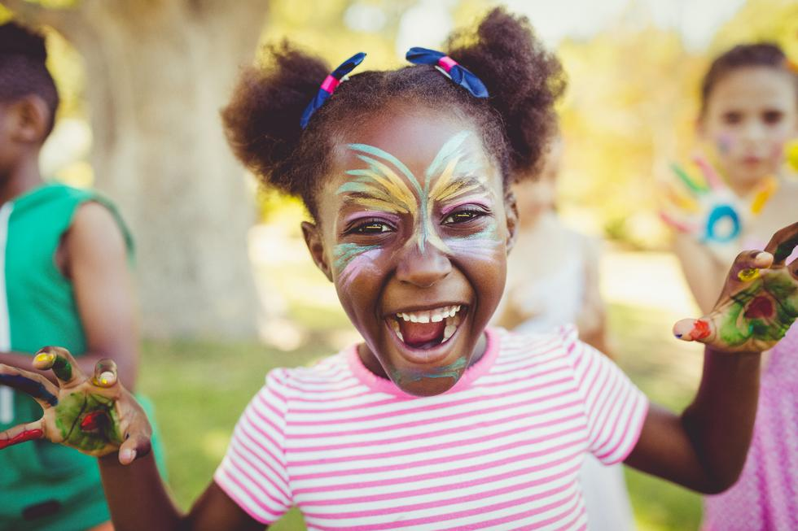
You try on the mascara. “Wow,” you say to yourself, “I look good!” But what brand should you buy, Tarte or Maybelline?
Choices Tarte Maybelline
Do Mi

Slide 24
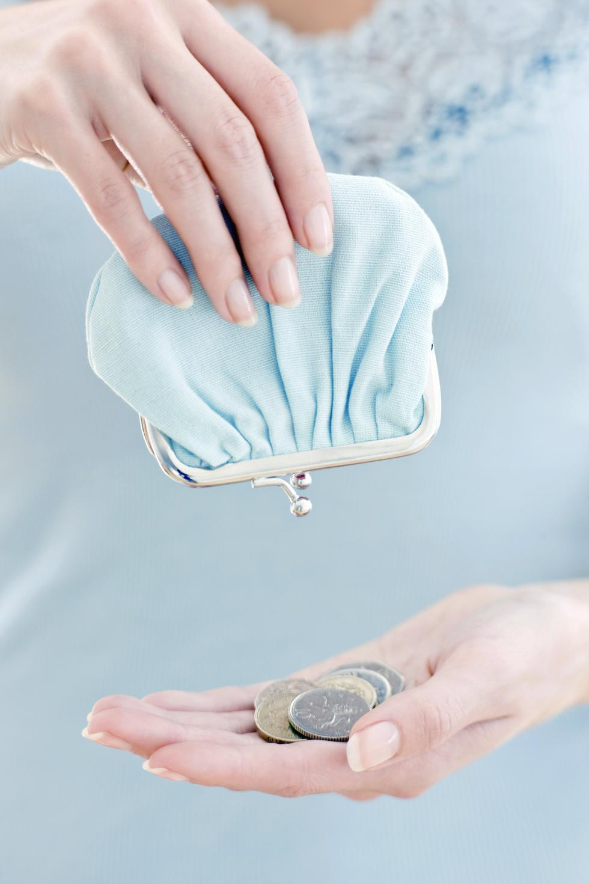
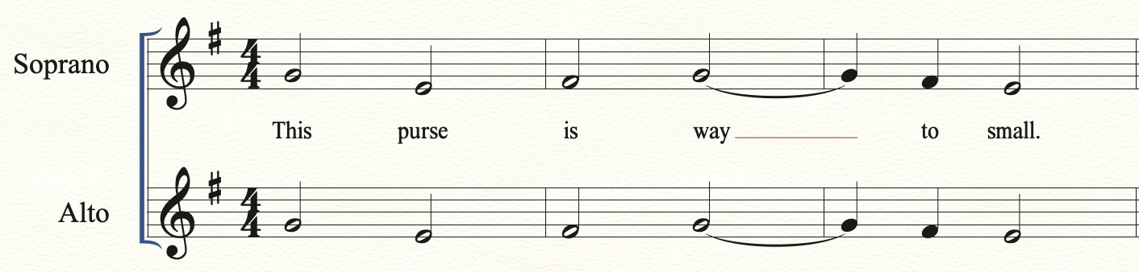
You walk up to the register to pay for the red purse. Upon further inspection you realize that this purse is way to small to fit all your things. You change your mind, put the purse back and save your money for another day.

Slide 25
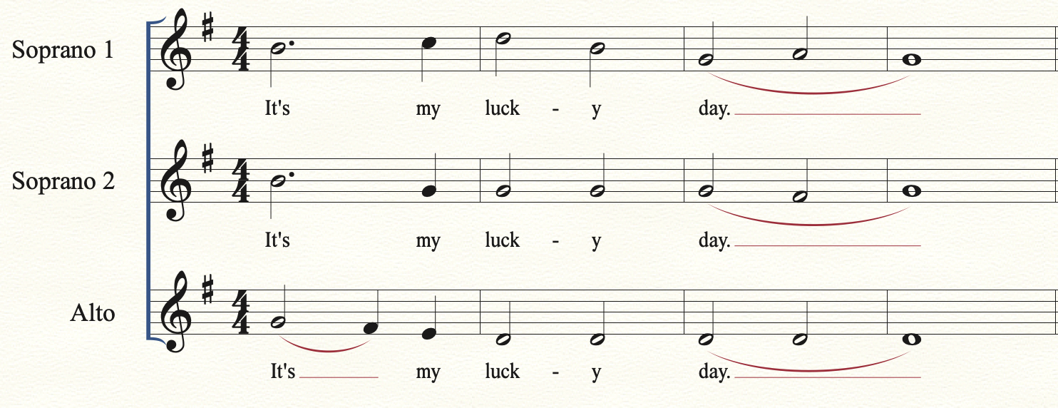
You take the item to the register. It’s your lucky day, as the clerk rings up your item you realize it was on sale and didn’t even know it! However, to get the extra savings you must first sing in three parts.

Slide 26
You walk up to the register, and to your surprise the clerk says, “These are on sale today, buy one get one free.” You can hardly contain your joy! But in order to get the sale price you must first sing in three parts.

Slide 27
You take your item up to the register. Oh no, you left your money at home! I guess you’ll just have to come back to the mall another day.

Slide 28
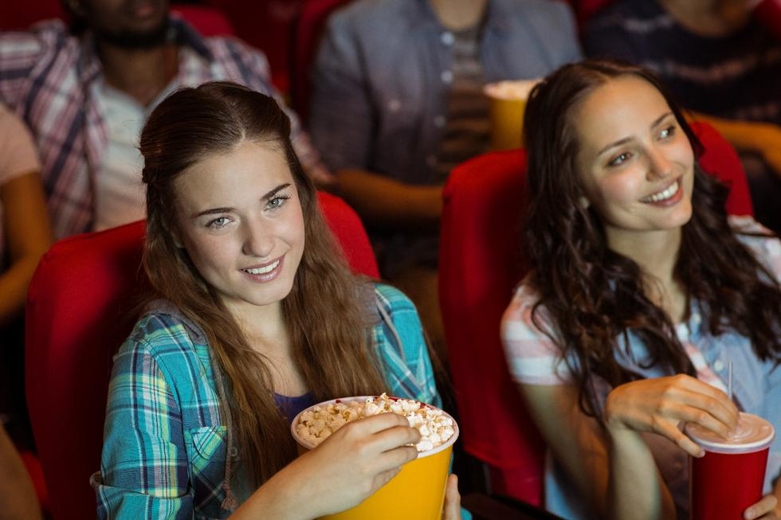
As you look at your choice again, you think to your self, “I would much rather spend my money on a movie.” Your friends agree, and you head to the theatre for the latest romantic comedy.

